Slide 1

Global Hedge Position
31/12/2020
KERIUS Finance SAS
Conseiller en Investissements Financiers
Membre de l’ANACOFI CIF- Association agréée par l’AMF - ORIAS N° 13000716

Slide 2
Contents
Global view
  Bitumen Purchase Price Performance
  Bitumen Hedging Summary
  Detailed analysis
    Synthesis by subsidiary/currency
    Historical prices
  Annexes

Slide 3
Bitumen Hedge Summary and
Purchase Price Performance
BITUMEN |  | Hedge Reference |  | Hedged (MT) | Exposure (MT) |  | Hedge Rate |  | Budget 2020 |  | Purchase price as of December 2020 |  | Average pruchase price of 2020 |  | Last year purchase price (December 2019) |  | Performance compared to Budget (%) |  | Performance compared to Average of 2020 (%) |  | Performance compared to Last year (%)
Russia |  | 2020 |  | 21 834 | 22 103 |  | 99% |  | 15 239 |  | - |  | 10 876 |  | - |  | 100,0% |  | 100,0% |  | -
Turkey |  | 2020 |  | 17 820 | 25 743 |  | 69% |  | 2 070 |  | 2 830 |  | 2 184 |  | 1 795 |  | -36,7% |  | -29,6% |  | -57,7%
Poland |  | 2020 |  | 9 967 | 13 161 |  | 76% |  | 1 411 |  | 1 244 |  | 1 246 |  | - |  | 11,8% |  | 0,2% |  | -
Spain |  | 2020 |  | 5 483 | 6 353 |  | 86% |  | 344 |  | - |  | 341 |  | - |  | 103,2% |  | 103,2% |  | -
Malaysia |  | 2020 |  | 2 911 | 4 301 |  | 68% |  | 1 930 |  | 1 660 |  | 1 708 |  | 2 039 |  | 14,0% |  | 2,8% |  | 18,6%
Brazil |  | 2020 |  | - | 2 491 |  | 0% |  | 2 844 |  | - |  | 2 366 |  | - |  | 100,0% |  | 100,0% |  | -

Slide 4
Bitumen Hedging Summary – Brent – BNP
Trade Date | Counterparty | Underlying | Period | Type |  | Quantity YTD in Barils | Unit trading | Traded Swap price € | Actual 2020 € | MTM Index 31/12/2020 | Premium | Exchange rate | Result in K€
 |  |  |  |  |  |  |  |  | YTD December
27/02/2020 | BNP | Brent | déc.-20 | € | Fixed | 7 249 | barils | 48,8 | 41,28 | 41,28 | 0 | 1,00 | -54,50
02/10/2020 | BNP | Brent | janv.-21 | € | Fixed | 2 300 | barils | 36,8 | 42,39 | 42,39 | 0 | 1,00 | 12,86
02/10/2020 | BNP | Brent | févr.-21 | € | Fixed | 2 800 | barils | 36,8 | 42,39 | 42,38 | 0 | 1,00 | 15,63
02/10/2020 | BNP | Brent | mars-21 | € | Fixed | 2 800 | barils | 36,8 | 42,39 | 42,32 | 0 | 1,00 | 15,46
02/10/2020 | BNP | Brent | avr.-21 | € | Fixed | 2 300 | barils | 36,8 | 42,39 | 42,19 | 0 | 1,00 | 12,40
02/10/2020 | BNP | Brent | mai-21 | € | Fixed | 2 400 | barils | 36,8 | 42,39 | 42,02 | 0 | 1,00 | 12,53
02/10/2020 | BNP | Brent | juin-21 | € | Fixed | 2 900 | barils | 36,8 | 42,39 | 41,89 | 0 | 1,00 | 14,75
02/10/2020 | BNP | Brent | juil.-21 | € | Fixed | 3 600 | barils | 36,8 | 42,39 | 41,73 | 0 | 1,00 | 17,77
02/10/2020 | BNP | Brent | août-21 | € | Fixed | 3 000 | barils | 36,8 | 42,39 | 41,58 | 0 | 1,00 | 14,33
02/10/2020 | BNP | Brent | sept.-21 | € | Fixed | 2 900 | barils | 36,8 | 42,39 | 41,43 | 0 | 1,00 | 13,42
30/10/2020 | BNP | Brent | janv.-21 | $ | Fixed | 1 700 | barils | 41,15 | 51,80 | 51,80 | 0 | 1,23 | 14,76
30/10/2020 | BNP | Brent | févr.-21 | $ | Fixed | 1 950 | barils | 41,15 | 51,80 | 51,82 | 0 | 1,23 | 16,96
30/10/2020 | BNP | Brent | mars-21 | $ | Fixed | 2 000 | barils | 41,15 | 51,80 | 51,78 | 0 | 1,23 | 17,34
30/10/2020 | BNP | Brent | avr.-21 | $ | Fixed | 1 700 | barils | 41,15 | 51,80 | 51,66 | 0 | 1,23 | 14,57
30/10/2020 | BNP | Brent | mai-21 | $ | Fixed | 1 750 | barils | 41,15 | 51,80 | 51,49 | 0 | 1,23 | 14,74
30/10/2020 | BNP | Brent | juin-21 | $ | Fixed | 2 100 | barils | 41,15 | 51,80 | 51,32 | 0 | 1,23 | 17,41
30/10/2020 | BNP | Brent | juil.-21 | $ | Fixed | 2 650 | barils | 41,15 | 51,80 | 51,20 | 0 | 1,23 | 21,71
30/10/2020 | BNP | Brent | août-21 | $ | Fixed | 2 200 | barils | 41,15 | 51,80 | 51,04 | 0 | 1,23 | 17,74
30/10/2020 | BNP | Brent | sept.-21 | $ | Fixed | 2 150 | barils | 41,15 | 51,80 | 50,89 | 0 | 1,23 | 17,07
30/10/2020 | BNP | Brent | oct.-21 | $ | Fixed | 1 800 | barils | 41,15 | 51,80 | 50,75 | 0 | 1,23 | 14,08
 | BNP |  |  |  |  | 52 249 | barils | 39,58 |  |  |  |  | 241

Slide 5
Bitumen Hedging Summary – Brent – Natixis
Trade Date | Counterparty | Underlying | Period | Type |  | Quantity YTD in Barils | Unit trading | Traded Swap price € | Actual 2020 € | MTM Index 31/12/2020 | Premium | Exchange rate | Result in K€
 |  |  |  |  |  |  |  |  | YTD December
02/10/2020 | NATIXIS | Brent | janv.-21 | € | Fixed | 2 300 | barils | 36,75 | 42,31 | 42,31 | 0 | 1,00 | 12,79
02/10/2020 | NATIXIS | Brent | févr.-21 | € | Fixed | 2 800 | barils | 36,75 | 42,31 | 42,30 | 0 | 1,00 | 15,54
02/10/2020 | NATIXIS | Brent | mars-21 | € | Fixed | 2 800 | barils | 36,75 | 42,31 | 42,24 | 0 | 1,00 | 15,37
02/10/2020 | NATIXIS | Brent | avr.-21 | € | Fixed | 2 300 | barils | 36,75 | 42,31 | 42,10 | 0 | 1,00 | 12,31
02/10/2020 | NATIXIS | Brent | mai-21 | € | Fixed | 2 400 | barils | 36,75 | 42,31 | 41,93 | 0 | 1,00 | 12,43
02/10/2020 | NATIXIS | Brent | juin-21 | € | Fixed | 2 900 | barils | 36,75 | 42,31 | 41,79 | 0 | 1,00 | 14,62
02/10/2020 | NATIXIS | Brent | juil.-21 | € | Fixed | 3 600 | barils | 36,75 | 42,31 | 41,64 | 0 | 1,00 | 17,60
02/10/2020 | NATIXIS | Brent | août-21 | € | Fixed | 3 000 | barils | 36,75 | 42,31 | 41,48 | 0 | 1,00 | 14,19
02/10/2020 | NATIXIS | Brent | sept.-21 | € | Fixed | 2 900 | barils | 36,75 | 42,31 | 41,33 | 0 | 1,00 | 13,30
30/10/2020 | NATIXIS | Brent | janv.-21 | $ | Fixed | 1 700 | barils | 41,12 | 51,80 | 51,80 | 0 | 1,23 | 14,80
30/10/2020 | NATIXIS | Brent | févr.-21 | $ | Fixed | 1 950 | barils | 41,12 | 51,80 | 51,82 | 0 | 1,23 | 17,00
30/10/2020 | NATIXIS | Brent | mars-21 | $ | Fixed | 2 000 | barils | 41,12 | 51,80 | 51,78 | 0 | 1,23 | 17,38
30/10/2020 | NATIXIS | Brent | avr.-21 | $ | Fixed | 1 700 | barils | 41,12 | 51,80 | 51,65 | 0 | 1,23 | 14,59
30/10/2020 | NATIXIS | Brent | mai-21 | $ | Fixed | 1 750 | barils | 41,12 | 51,80 | 51,47 | 0 | 1,23 | 14,76
30/10/2020 | NATIXIS | Brent | juin-21 | $ | Fixed | 2 100 | barils | 41,12 | 51,80 | 51,33 | 0 | 1,23 | 17,48
30/10/2020 | NATIXIS | Brent | juil.-21 | $ | Fixed | 2 650 | barils | 41,12 | 51,80 | 51,18 | 0 | 1,23 | 21,72
30/10/2020 | NATIXIS | Brent | août-21 | $ | Fixed | 2 200 | barils | 41,12 | 51,80 | 51,02 | 0 | 1,23 | 17,75
30/10/2020 | NATIXIS | Brent | sept.-21 | $ | Fixed | 2 150 | barils | 41,12 | 51,80 | 50,87 | 0 | 1,23 | 17,09
30/10/2020 | NATIXIS | Brent | oct.-21 | $ | Fixed | 1 800 | barils | 41,12 | 51,80 | 50,73 | 0 | 1,23 | 14,10
30/10/2020 | NATIXIS | Brent | janv.-21 | $ | Call | 3 400 | barils | 50,00 | 52,35 | 52,35 | 8 160 | 1,23 | 6,51
30/10/2020 | NATIXIS | Brent | févr.-21 | $ | Call | 3 900 | barils | 50,00 | 52,35 | 53,44 | 9 360 | 1,23 | 10,94
30/10/2020 | NATIXIS | Brent | mars-21 | $ | Call | 4 000 | barils | 50,00 | 52,35 | 54,18 | 9 600 | 1,23 | 13,63
30/10/2020 | NATIXIS | Brent | avr.-21 | $ | Call | 3 400 | barils | 50,00 | 52,35 | 54,77 | 8 160 | 1,23 | 13,22
30/10/2020 | NATIXIS | Brent | mai-21 | $ | Call | 3 500 | barils | 50,00 | 52,35 | 55,17 | 8 400 | 1,23 | 14,75
30/10/2020 | NATIXIS | Brent | juin-21 | $ | Call | 4 200 | barils | 50,00 | 52,35 | 55,56 | 10 080 | 1,23 | 19,03
30/10/2020 | NATIXIS | Brent | juil.-21 | $ | Call | 5 300 | barils | 50,00 | 52,35 | 55,90 | 12 720 | 1,23 | 25,49
30/10/2020 | NATIXIS | Brent | août-21 | $ | Call | 4 400 | barils | 50,00 | 52,35 | 56,14 | 10 560 | 1,23 | 22,02
30/10/2020 | NATIXIS | Brent | sept.-21 | $ | Call | 4 300 | barils | 50,00 | 52,35 | 56,35 | 10 320 | 1,23 | 22,26
30/10/2020 | NATIXIS | Brent | oct.-21 | $ | Call | 3 600 | barils | 50,00 | 52,35 | 56,55 | 8 640 | 1,23 | 19,22
 | NATIXIS |  |  |  |  | 85 000 | barils | 42,83 |  |  | 96 000 |  | 462
 |  |  | TOTAL |  |  | 137 249 | barils | 41,35 |  |  | 96 000 |  | 703

Slide 6
Bitumen Hedging Summary - 2020
Subsidiaries | Quantity in MT | January | February | March | April | May | June | July | August | September | October | November | December |  | Total
RUSSIA | Consummed quantity | 1 427 | 2 072 | 2 220 | 1 048 | 1 335 | 2 800 | 2 857 | 2 740 | 2 337 | 2 177 | 1 090 | 0 |  | 22 103
 | Hegded quantity | 1 797 | 2 022 | 1 950 | 1 680 | 1 957 | 1 890 | 2 247 | 2 113 | 2 445 | 2 193 | 981 | 559 |  | 21 834
 | Hedge ratio | 126% | 98% | 88% | 160% | 147% | 67% | 79% | 77% | 105% | 101% | 90% | 0% |  | 99%
TURKEY | Consummed quantity | 1 954 | 2 732 | 1 951 | 0 | 1 292 | 1 820 | 2 588 | 3 021 | 2 911 | 2 816 | 2 614 | 2 044 |  | 25 743
 | Hegded quantity | 1 391 | 1 476 | 1 976 | 1 802 | 1 772 | 1 771 | 2 029 | 1 323 | 1 638 | 1 541 | 690 | 410 |  | 17 820
 | Hedge ratio | 71% | 54% | 101% | - | 137% | 97% | 78% | 44% | 56% | 55% | 26% | 20% |  | 69%
POLAND | Consummed quantity | 769 | 897 | 1 105 | 799 | 1 078 | 1 387 | 1 367 | 1 386 | 1 261 | 1 567 | 1 315 | 231 |  | 13 161
 | Hegded quantity | 803 | 847 | 1 116 | 1 024 | 1 185 | 1 147 | 809 | 771 | 887 | 808 | 361 | 210 |  | 9 967
 | Hedge ratio | 104% | 94% | 101% | 128% | 110% | 83% | 59% | 56% | 70% | 52% | 27% | 110% |  | 76%
SPAIN | Consummed quantity | 739 | 725 | 363 | 0 | 361 | 1 004 | 670 | 52 | 592 | 924 | 769 | 154 |  | 6 353
 | Hegded quantity | 441 | 455 | 660 | 613 | 701 | 693 | 429 | 389 | 439 | 387 | 173 | 101 |  | 5 483
 | Hedge ratio | 60% | 63% | 182% | - | 194% | 69% | 64% | 749% | 74% | 42% | 23% | 152% |  | 86%
MALAYSIA | Consummed quantity | 469 | 517 | 330 | 30 | 268 | 487 | 462 | 500 | 490 | 446 | 272 | 30 |  | 4 301
 | Hegded quantity | 242 | 272 | 240 | 207 | 257 | 257 | 306 | 292 | 348 | 291 | 130 | 69 |  | 2 911
 | Hedge ratio | 52% | 53% | 73% | 692% | 96% | 53% | 66% | 58% | 71% | 65% | 48% | 228% |  | 68%
BRAZIL | Consummed quantity | 175 | 267 | 179 | 0 | 0 | 274 | 148 | 237 | 416 | 387 | 407 | 0 |  | 2 491
 | Hegded quantity | - | - | - | - | - | - | - | - | - | - | - | - |  | -
 | Hedge ratio | 0% | 0% | 0% | 0% | 0% | 0% | 0% | 0% | 0% | 0% | 0% | 0% |  | 0%
TOTAL GROUP | Consummed quantity | 5 532 | 7 209 | 6 149 | 1 876 | 4 334 | 7 773 | 8 092 | 7 936 | 8 007 | 8 318 | 6 467 | 2 459 |  | 74 153
 | Hegded quantity | 4 674 | 5 072 | 5 942 | 5 326 | 5 872 | 5 758 | 5 820 | 4 889 | 5 758 | 5 220 | 2 336 | 1 348 |  | 58 015
 | Hedge ratio | 87% | 73% | 100% | 284% | 135% | 74% | 72% | 62% | 72% | 63% | 36% | 55% |  | 78%
Le ratio de couverture est susceptible de changer du fait de l’utilisation de deux ratios de conversion du baril en métrique tonne (-> 4 pour la Russie et 6,35 pour les autres filiales)

Slide 7
Bitumen Hedging Summary - 2021
Subsidiaries | Quantity in MT | January | February | March | April | May | June | July | August | September | October | November | December |  | Total
RUSSIA | Consummed quantity | 1 585 | 2 459 | 2 759 | 2 677 | 2 759 | 1 093 | 1 093 | 1 667 | 2 213 | 1 912 | 546 | 0 |  | 20 763
 | Hegded quantity | 479 | 564 | 572 | 479 | 496 | 597 | 749 | 622 | 606 | 303 | 0 | 0 |  | 5 468
 | Hedge ratio | 30% | 23% | 21% | 18% | 18% | 55% | 68% | 37% | 27% | 16% | 0% | 0% |  | 26%
TURKEY | Consummed quantity | 1 710 | 1 302 | 2 421 | 1 490 | 589 | 1 793 | 2 866 | 2 232 | 3 259 | 2 711 | 2 317 | 2 289 |  | 24 979
 | Hegded quantity | 577 | 678 | 688 | 577 | 597 | 719 | 901 | 749 | 729 | 364 | 0 | 0 |  | 6 578
 | Hedge ratio | 34% | 52% | 28% | 39% | 101% | 40% | 31% | 34% | 22% | 13% | 0% | 0% |  | 26%
POLAND | Consummed quantity | 816 | 908 | 1 080 | 1 328 | 1 389 | 1 257 | 1 578 | 1 204 | 1 129 | 962 | 953 | 0 |  | 12 604
 | Hegded quantity | 291 | 342 | 347 | 291 | 301 | 363 | 454 | 378 | 368 | 184 | 0 | 0 |  | 3 319
 | Hedge ratio | 36% | 38% | 32% | 22% | 22% | 29% | 29% | 31% | 33% | 19% | 0% | 0% |  | 26%
SPAIN | Consummed quantity | 632 | 744 | 504 | 468 | 680 | 564 | 546 | 238 | 756 | 439 | 389 | 2 |  | 5 962
 | Hegded quantity | 138 | 162 | 164 | 138 | 143 | 171 | 215 | 179 | 174 | 87 | 0 | 0 |  | 1 570
 | Hedge ratio | 22% | 22% | 33% | 29% | 21% | 30% | 39% | 75% | 23% | 20% | 0% | 0% |  | 26%
MALAYSIA | Consummed quantity | 88 | 455 | 595 | 489 | 443 | 463 | 341 | 406 | 416 | 382 | 423 | 304 |  | 4 805
 | Hegded quantity | 111 | 130 | 132 | 111 | 115 | 138 | 173 | 144 | 140 | 70 | 0 | 0 |  | 1 265
 | Hedge ratio | 126% | 29% | 22% | 23% | 26% | 30% | 51% | 35% | 34% | 18% | 0% | 0% |  | 26%
BRAZIL | Consummed quantity | 0 | 297 | 344 | 88 | 339 | 348 | 259 | 245 | 126 | 140 | 102 | 0 |  | 2 288
 | Hegded quantity | 0 | 0 | 0 | 0 | 0 | 0 | 0 | 0 | 0 | 0 | 0 | 0 |  | -
 | Hedge ratio | 0% | 0% | 0% | 0% | 0% | 0% | 0% | 0% | 0% | 0% | 0% | 0% |  | 0%
TOTAL GROUP | Consummed quantity | 4 831 | 6 165 | 7 703 | 6 540 | 6 199 | 5 518 | 6 683 | 5 992 | 7 899 | 6 546 | 4 730 | 2 595 |  | 71 401
 | Hegded quantity | 1 596 | 1 876 | 1 904 | 1 596 | 1 652 | 1 988 | 2 492 | 2 072 | 2 016 | 1 008 | 0 | 0 |  | 18 200
 | Hedge ratio | 33% | 30% | 25% | 24% | 27% | 36% | 37% | 35% | 26% | 15% | 0% | 0% |  | 25%
Les quantités de bitume consommées sont estimées pour l’année 2021.
Ratio de conversion : 7.14

Slide 8
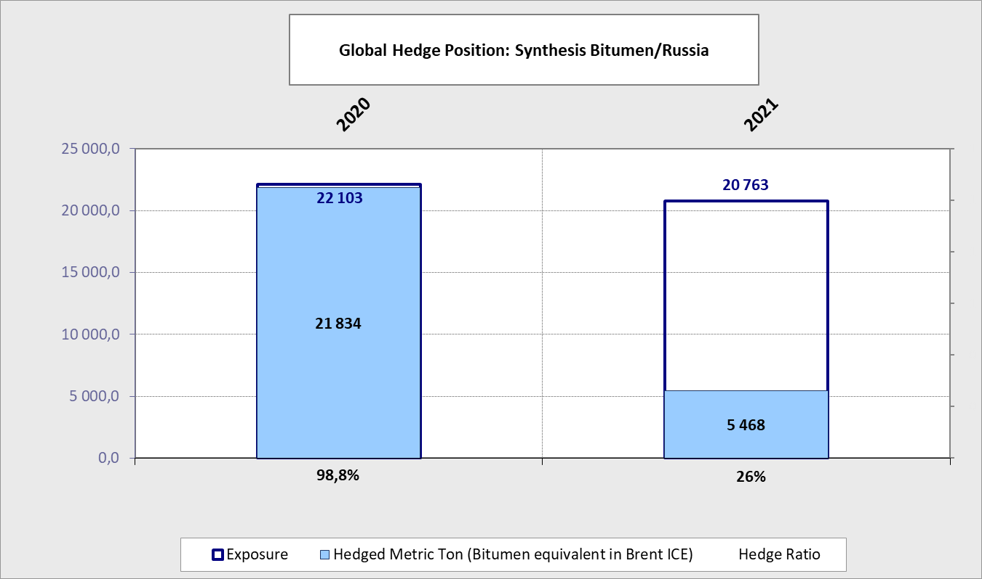
Bitumen/RUB - Synthesis
Conversion rate from Brent barrels to MT (2020) : 6.35
Conversion rate from Brent barrels to MT (2021) : 7.14

Slide 9
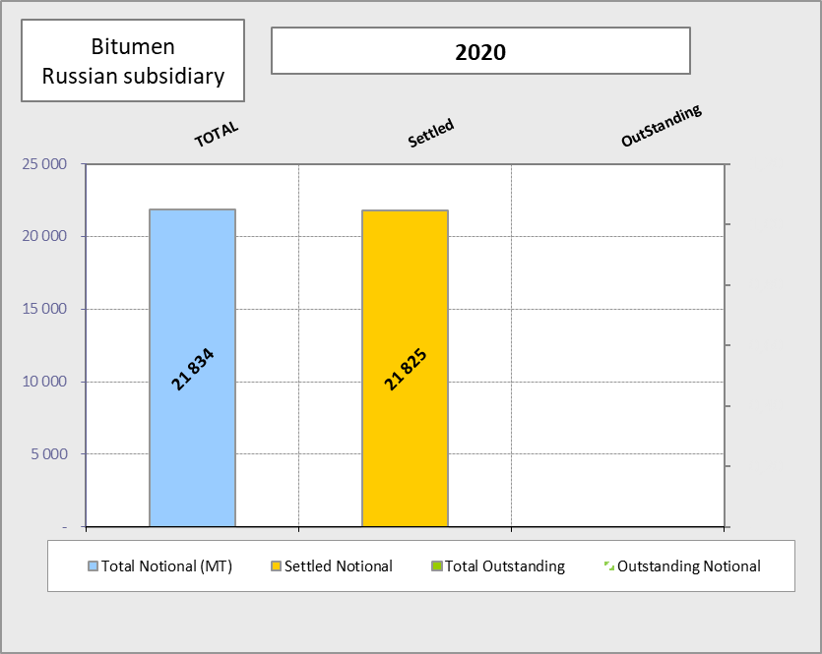
Russian subsidiary - 2020

Slide 10
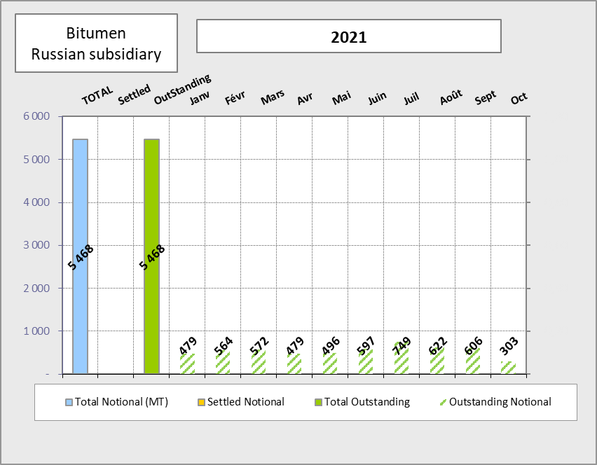
Russian subsidiary - 2021

Slide 11
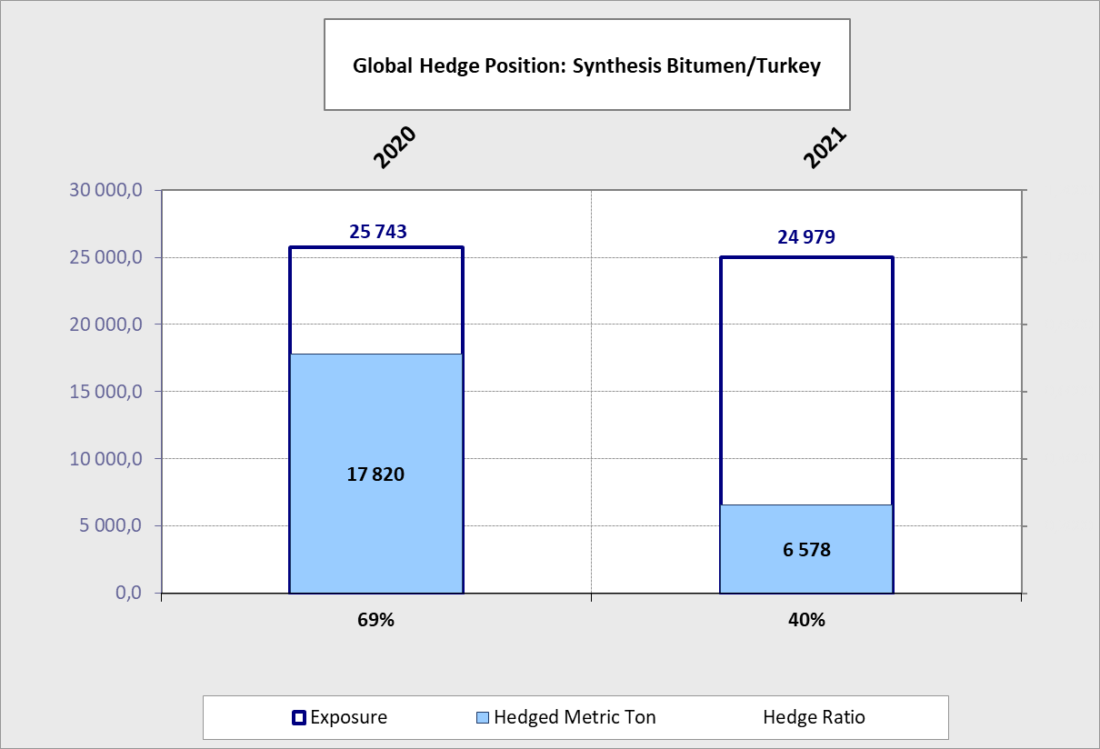
Turkish subsidiary - Synthesis
Conversion rate from Brent barrels to MT (2020) : 6.35
Conversion rate from Brent barrels to MT (2021) : 7.14

Slide 12
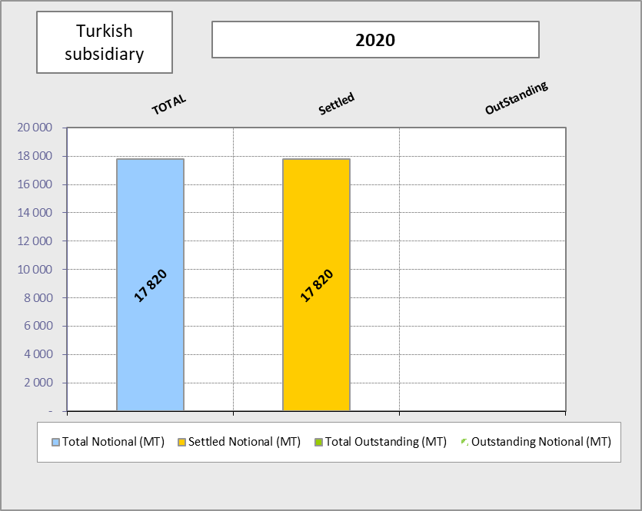
Turkish subsidiary - 2020

Slide 13
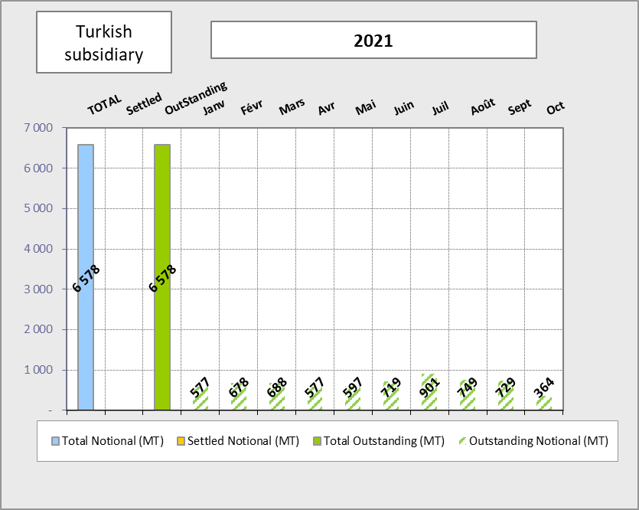
Turkish subsidiary - 2021

Slide 14
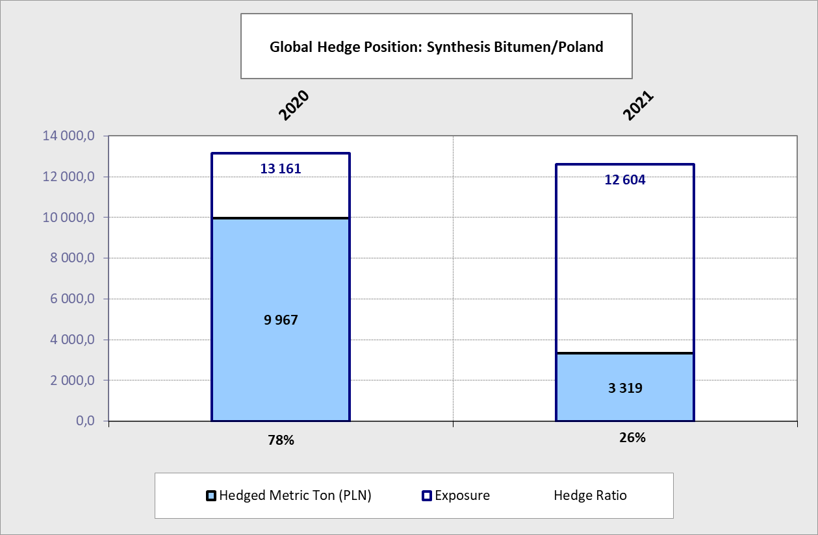
Polish subsidiary - Synthesis
Conversion rate from Brent barrels to MT (2020) : 6.35
Conversion rate from Brent barrels to MT (2021) : 7.14

Slide 15

Polish subsidiary - 2020

Slide 16
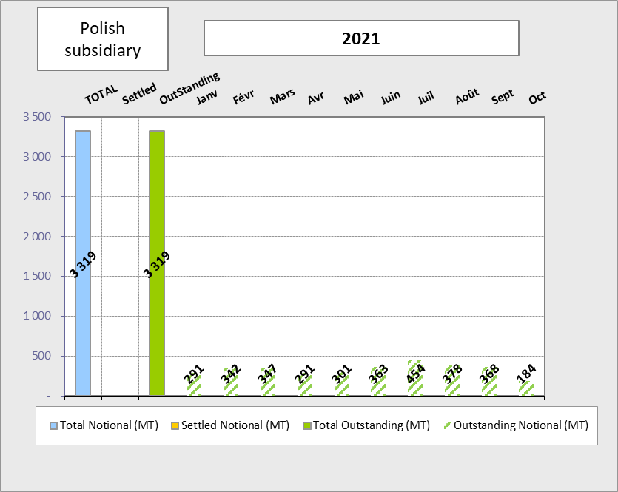
Polish subsidiary - 2021

Slide 17
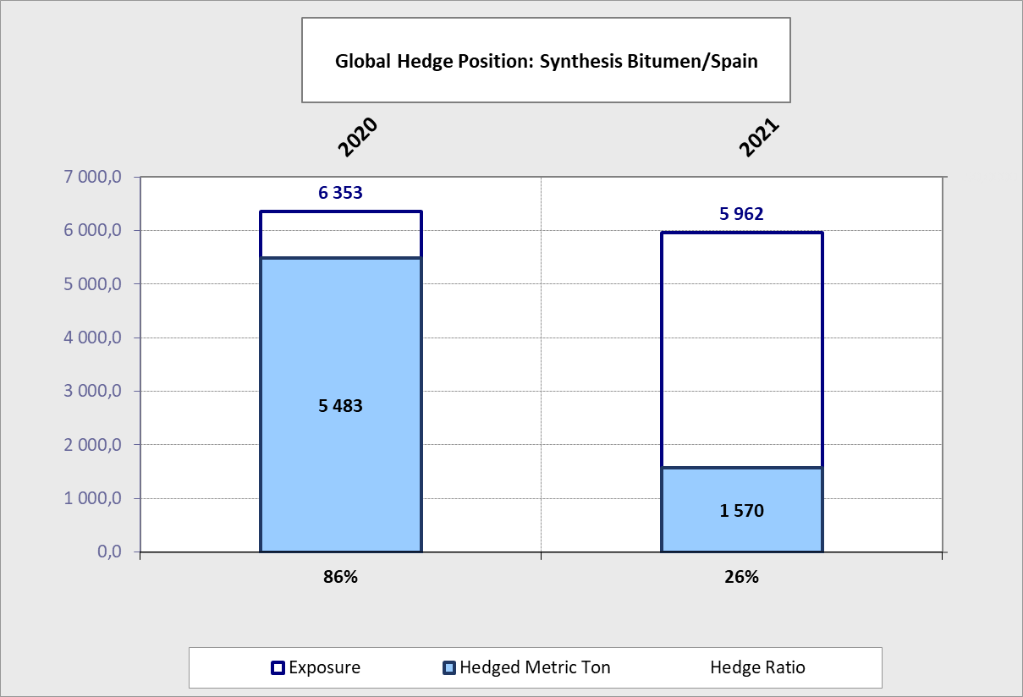
Spanish subsidiary - Synthesis
Conversion rate from Brent barrels to MT (2020) : 6.35
Conversion rate from Brent barrels to MT (2021) : 7.14

Slide 18
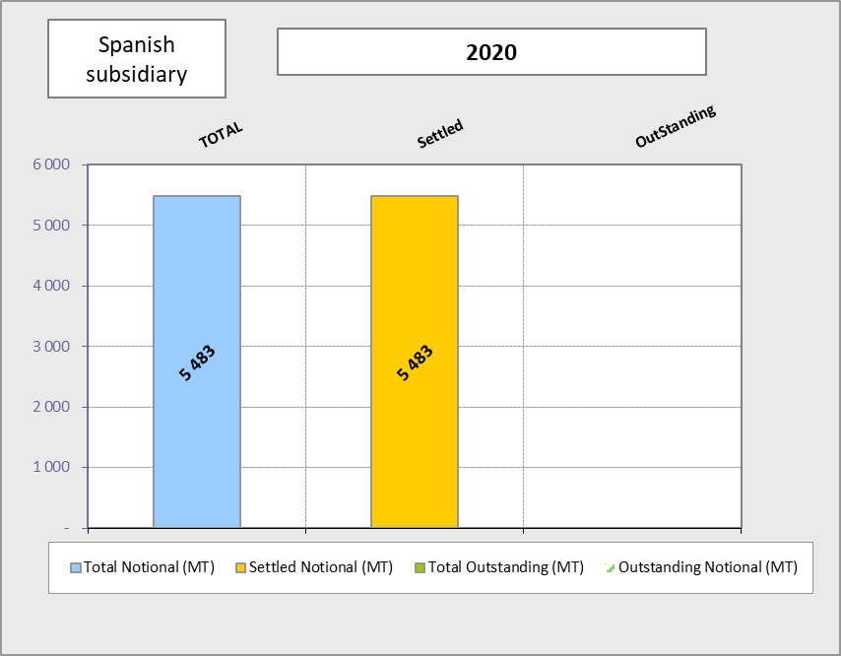
Spanish subsidiary - 2020

Slide 19
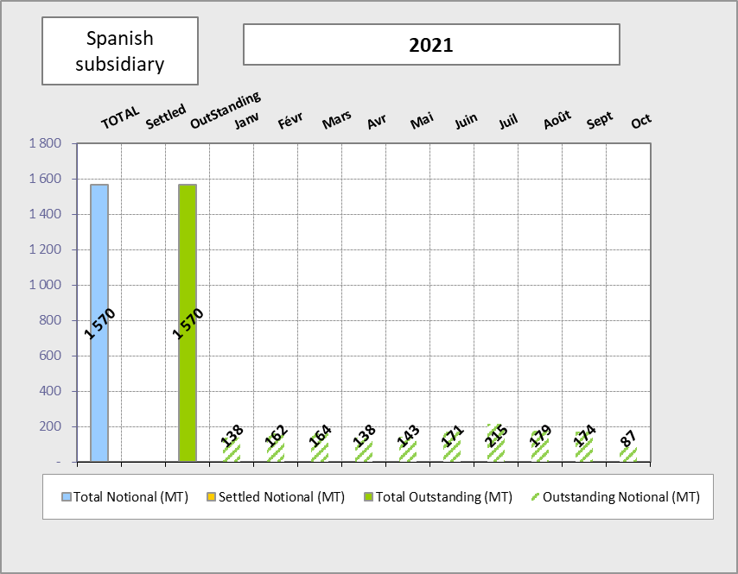
Spanish subsidiary - 2021

Slide 20
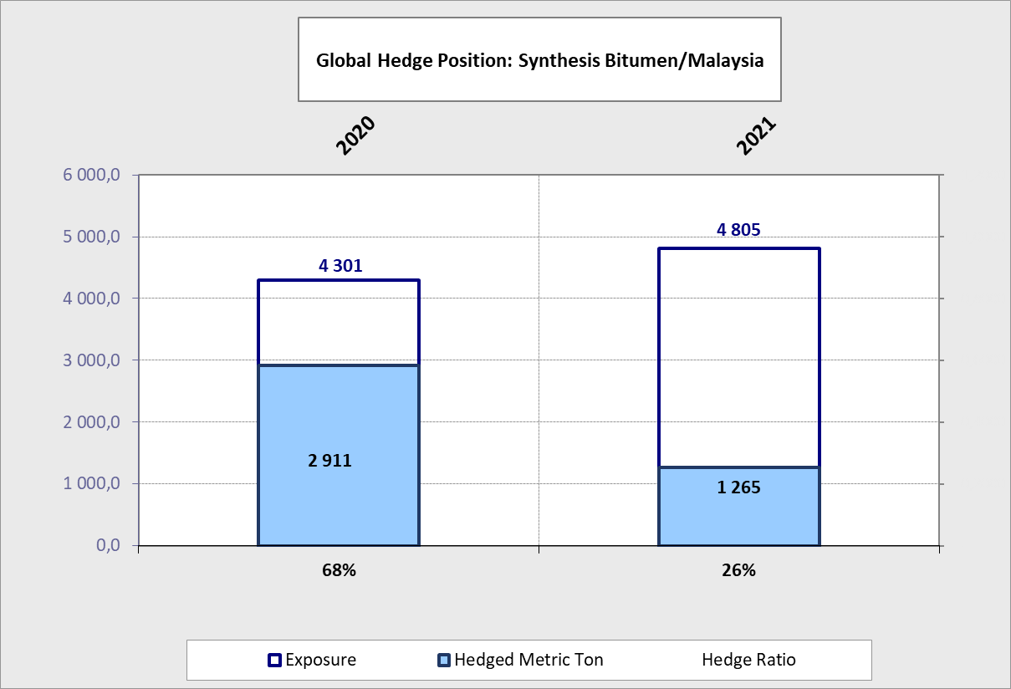
Malaysian subsidiary - Synthesis
Conversion rate from Brent barrels to MT (2020) : 6.35
Conversion rate from Brent barrels to MT (2021) : 7.14

Slide 21
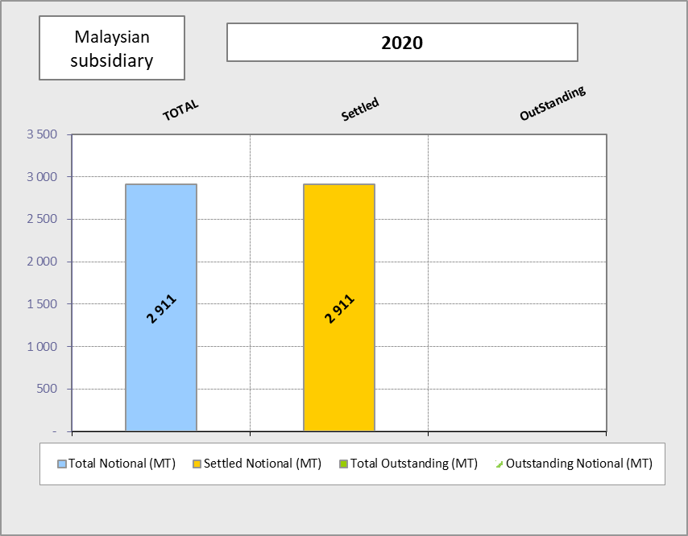
Malaysian subsidiary - 2020

Slide 22
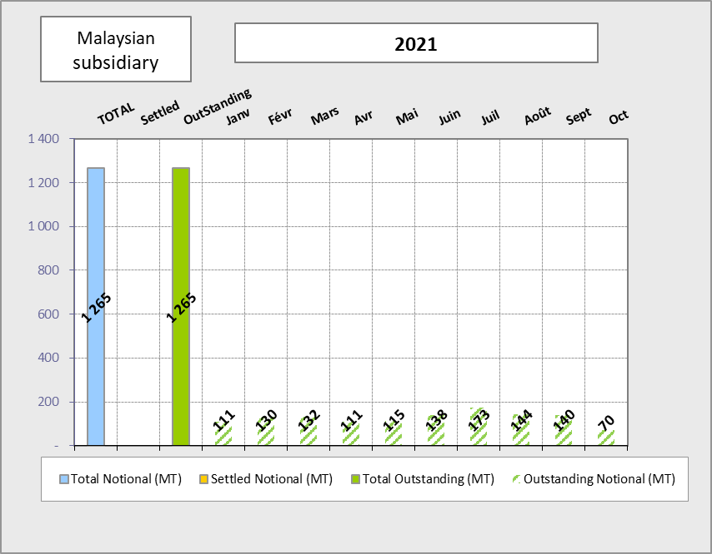
Malaysian subsidiary - 2021

Slide 23
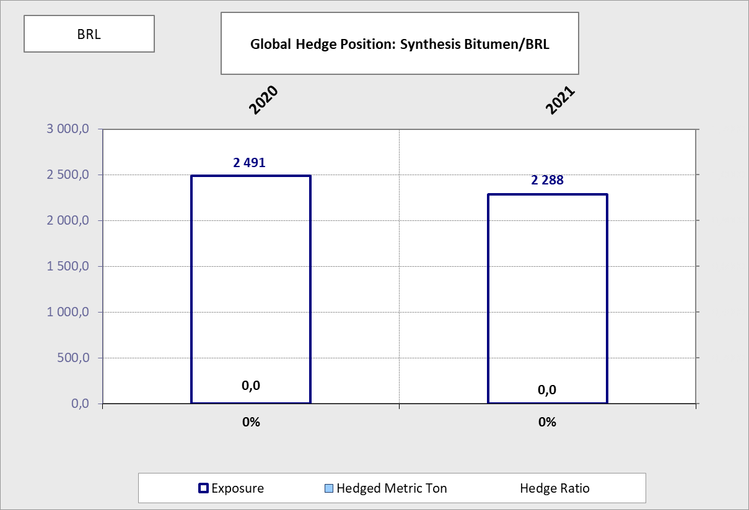
Bitumen/BRL - Synthesis

Slide 24
Correlation Analysis
At Cie Level, la corrélation Bitume vs FO et Brent est bonne à fin Décembre 2020 de l’ordre de 0,87.
On remarque que les meilleurs résultats sont obtenus avec un décalage d’1 mois.

Slide 25
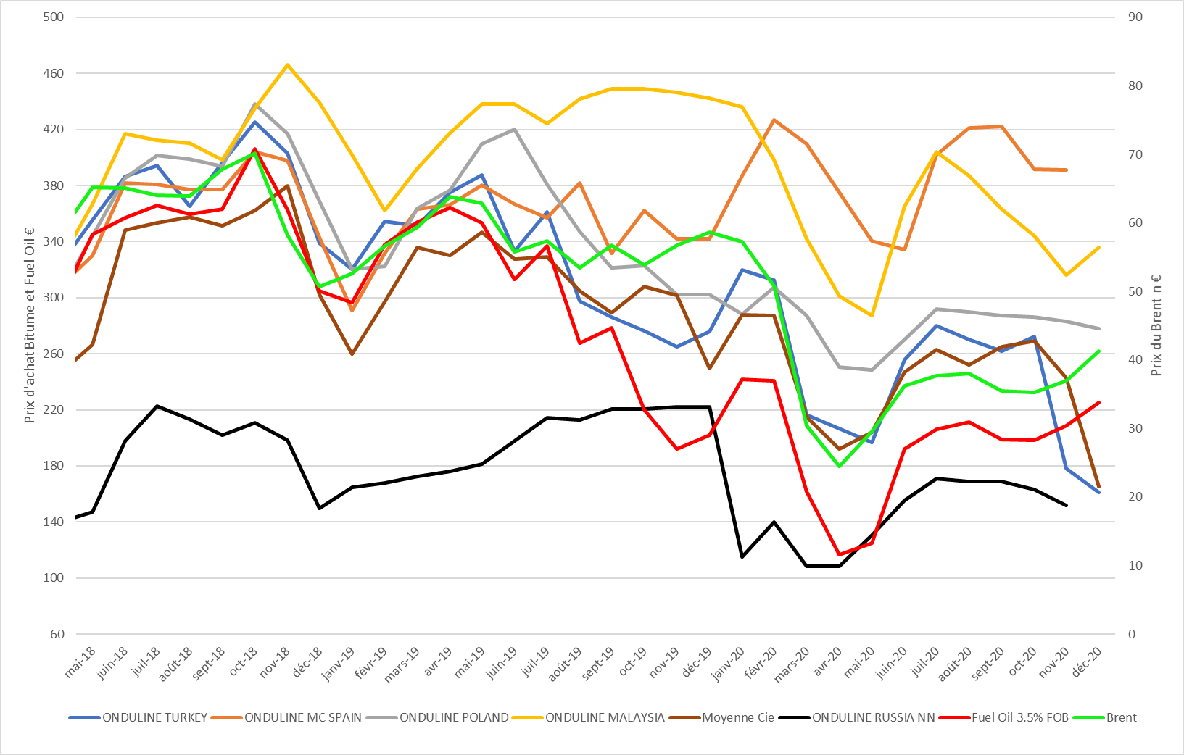
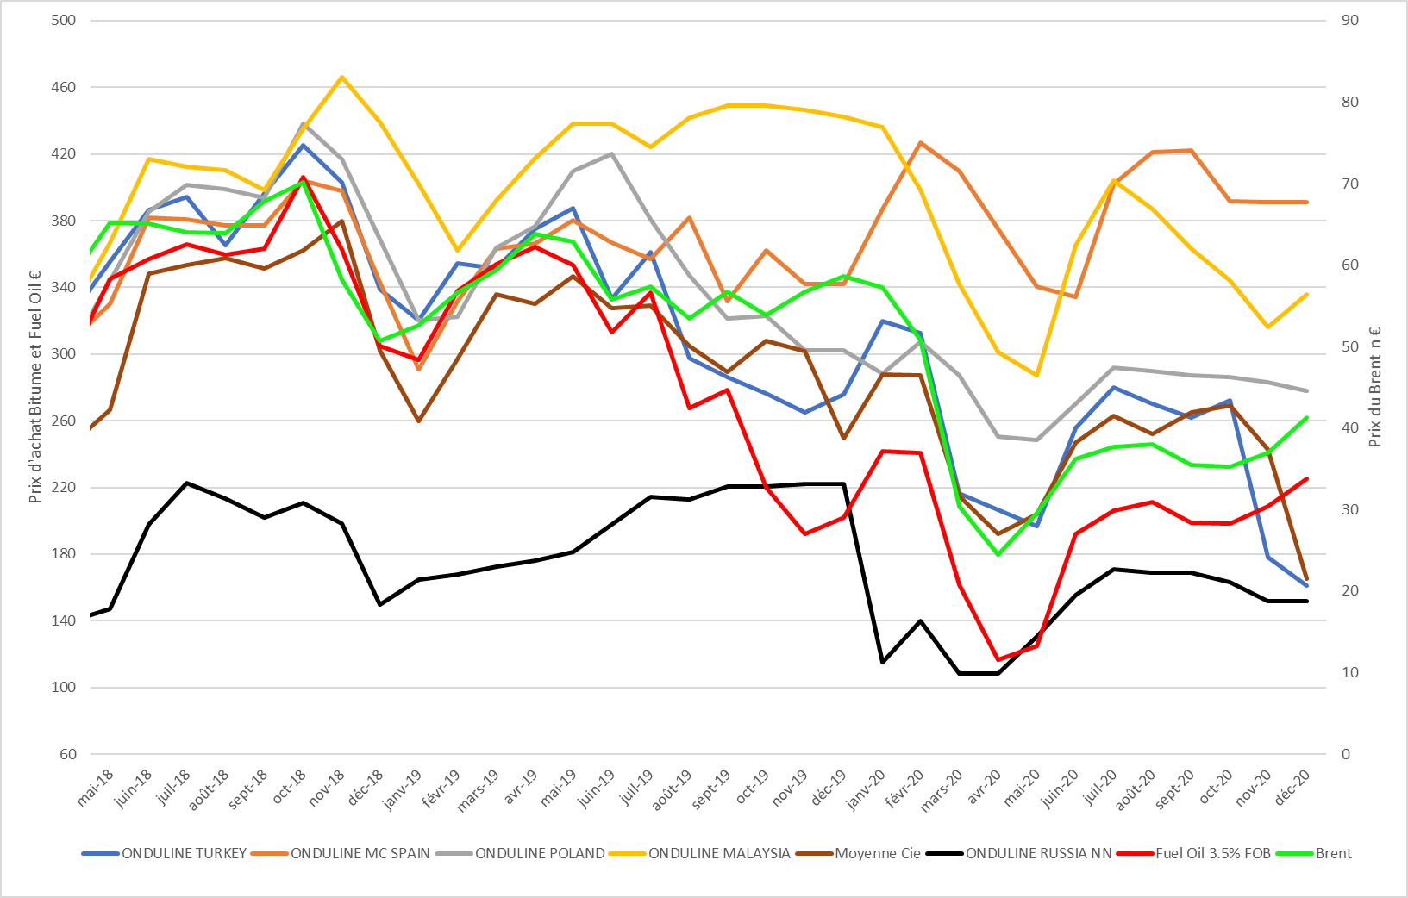
Historical Purchase Prices

Slide 26
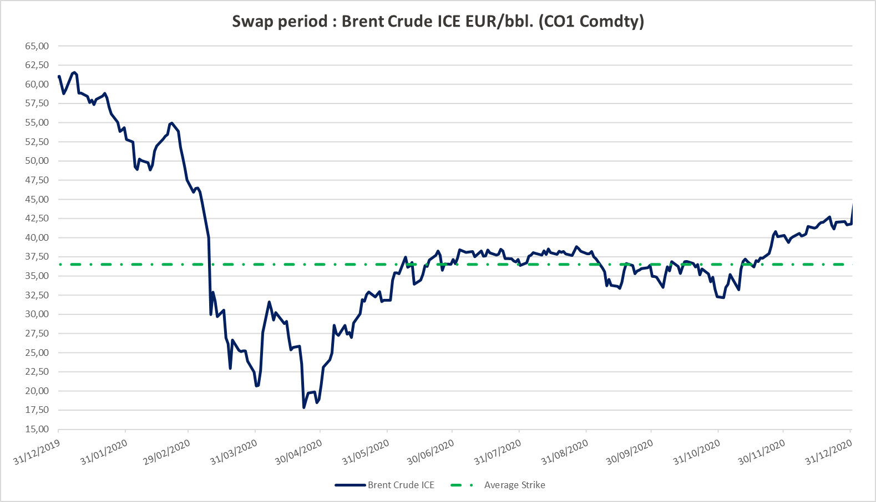
Historical prices: Brent
41.50 EUR = Average Strike

Slide 27
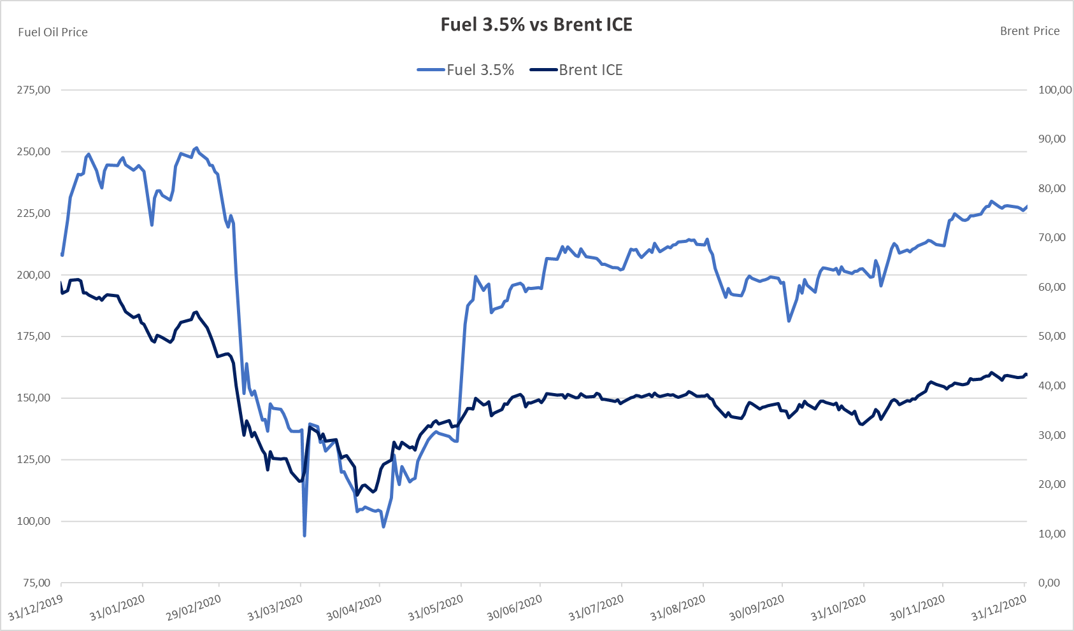
Historical prices: FO vs BRENT

Slide 28
Annexes
Historical prices: Fuel oil VS Brent

Slide 29
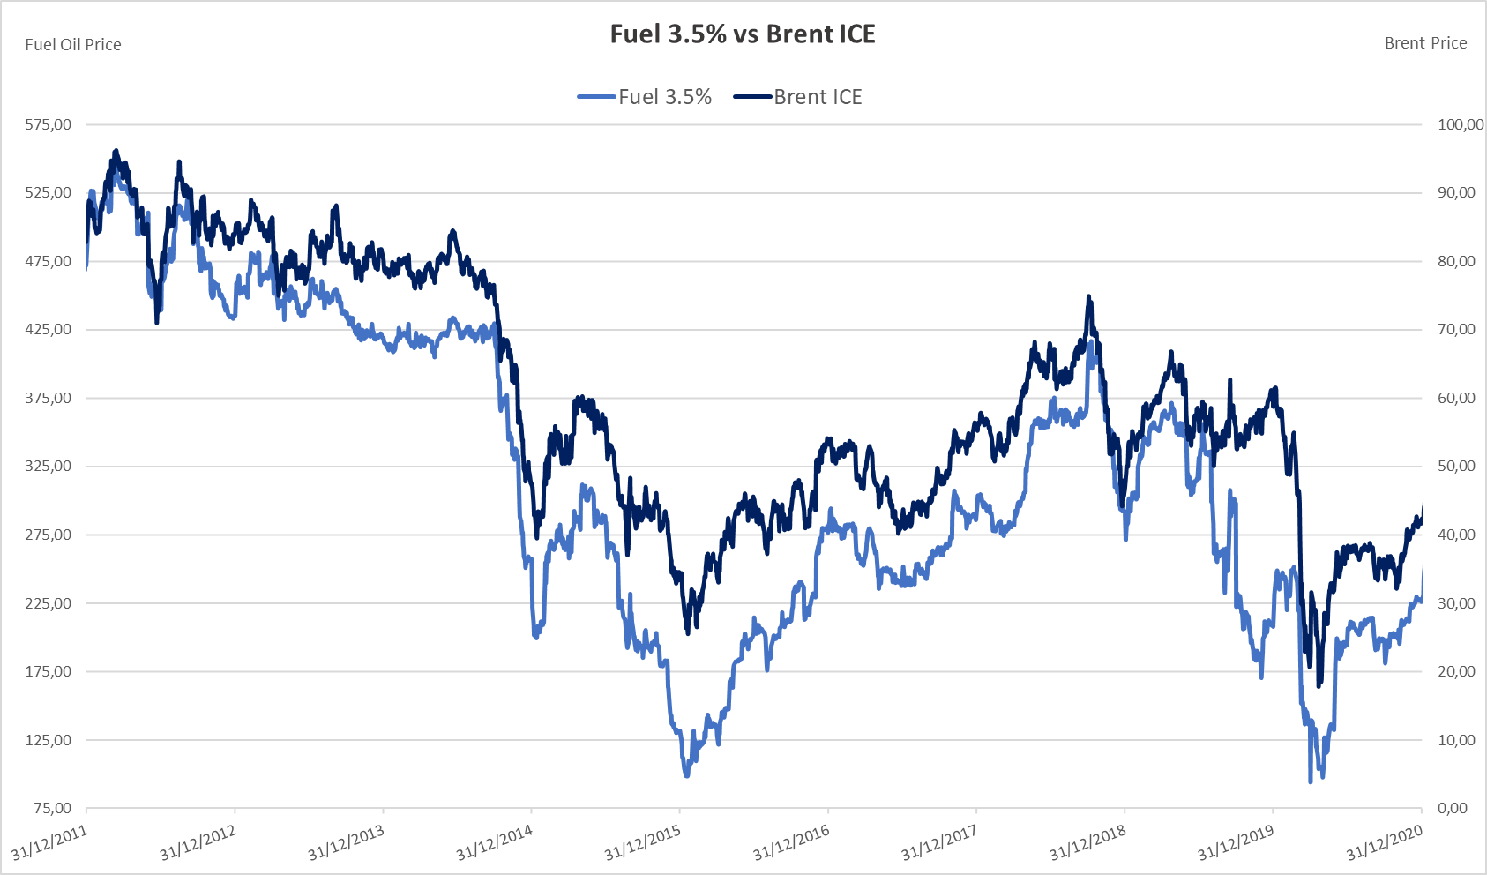
Historical prices

Slide 30
KERIUS Finance Suisse SARL
Chemin de Blandonnet 2,
1214 Vernier - Genève, Suisse
Tel : + 41 22 566 40 52
RC Genève, numéro fédéral: CH-660-2330011-1
KERIUS Finance SAS
17 rue Dupin,
75006 Paris, France
Tel: +33 1 83 62 27 61
RC Paris: 520 300 948
Immatriculé au Registre Unique des Intermédiaire en Assurance, Banque et Finance (ORIAS) sous le n°13000716 au titre des activités de Conseiller en Investissements Financiers, enregistré auprès de l’Association Nationale des Conseils Financiers-CIF, association agréée par l’Autorité des Marchés Financiers .
www.kerius-finance.com
Sébastien Rouzaire
s.rouzaire@kerius-finance.com
2013-12-04

Slide 31
AVERTISSEMENT - DISCLAIMER
Ce document a été préparé à l’usage des services financiers du Client. Ce document ou son contenu ne doivent pas être communiqués ou diffusés en externe sans l’accord préalable écrit de KERIUS FINANCE .
Pour ce document, KERIUS FINANCE a été amenée à utiliser des informations et données chiffrées fournies par le Client. KERIUS FINANCE a pris ces données en compte sans réaliser de procédure d’audit et n’émettra en conséquence aucune opinion sur leur fiabilité. Ce document ne constitue pas une documentation contractuelle des transactions éventuellement décrites, ni une recommandation ou une sollicitation de mettre en place les transactions décrites. Tout Client intéressé par ce type de transactions ou procédure doit mener ses propres analyses pour vérifier l’adéquation à ses besoins, ainsi que les conséquences, notamment fiscales et comptables. Il lui appartient également de prendre les dispositions nécessaires à la mise en œuvre des décisions qu’il aura prises.
Ni KERIUS FINANCE ou ses administrateurs ou employés ne pourront être tenus responsables des conséquences de l’utilisation de ce document ou de la mise en place, totale ou partielle, par le client, des idées ou opérations décrites.
This document has been prepared for the Finance department of the Client. It must not be communicated or published externally without prior written consent of KERIUS FINANCE
For this document, KERIUS FINANCE used information and data provided by the Client. The Client agrees that KERIUS FINANCE took this information into account without auditing them or checking their accuracy and, as a consequence, without producing any opinion on their reliability. Please note that this document does not constitute a contractual documentation of the transactions or processes that may be described, nor a recommendation or solicitation to enter into the transactions or processes described herein. If the Client is interested in setting up this type of transactions or processes, the Client should conduct his own analysis of the suitability to his needs. The Client must also verify the consequences of his decisions, including accounting and fiscal aspects. The Client is also responsible for the implementation of his decisions.
Neither KERIUS FINANCE nor its directors and employees accept liability for any loss or damage resulting from the use of this document and expressly excludes all liability in respect of any implication of the described ideas or transactions on the Client’s own specific particulars.
2013-01-01

