Slide 1

Global Hedge Position
30/11/2021
KERIUS Finance SAS
Conseiller en Investissements Financiers
Membre de l’ANACOFI CIF- Association agréée par l’AMF - ORIAS N° 13000716

Slide 2
Contents
Global view
  Hedging Summary
  Hedging Performance
  Options premium synthesis (if any)
  Sensitivity
  Detailed analysis by currency
    Historical & forward curves vs budget & hedge rates
    Hedge Schedule
    Hedging Analysis

Slide 3
Global view

Slide 4
Hedging Summary

Slide 5
Hedging Performance

Slide 6
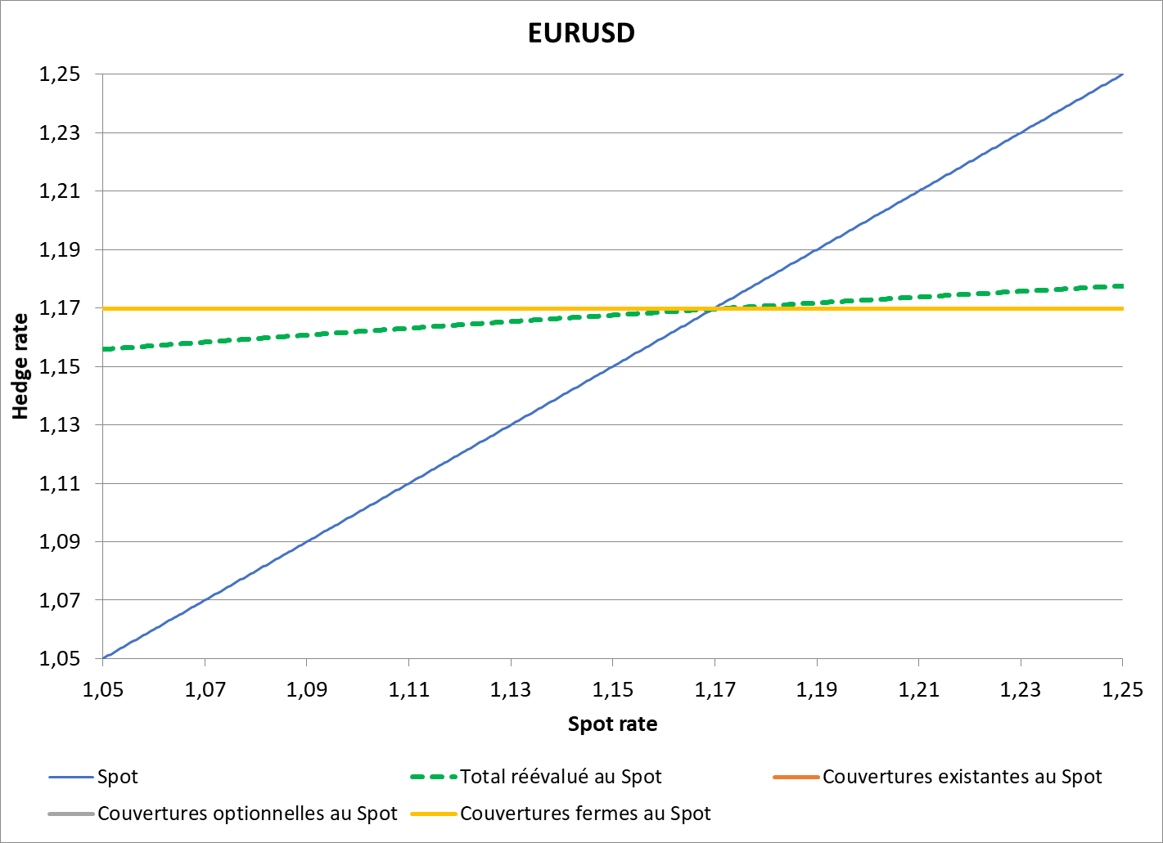
Sensitivity EURUSD

Slide 7
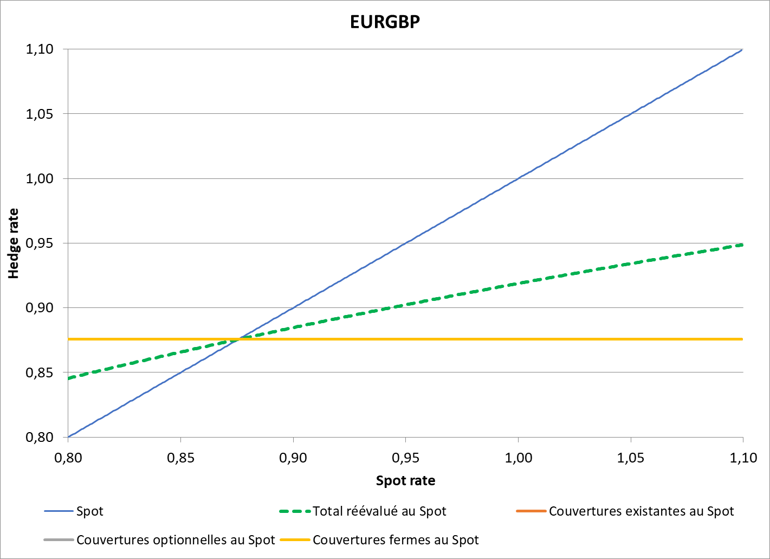
Sensitivity EURGBP

Slide 8
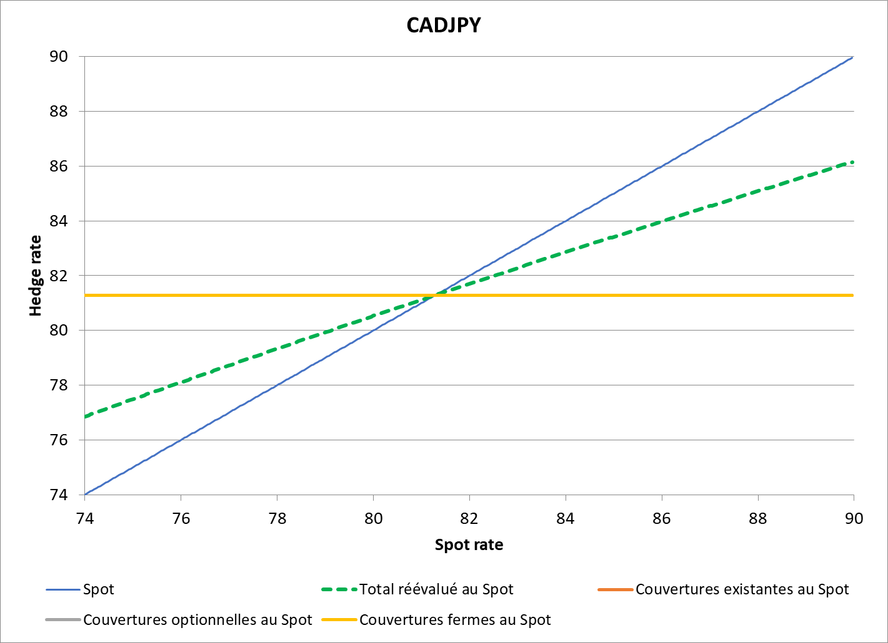
Sensitivity CADJPY

Slide 9
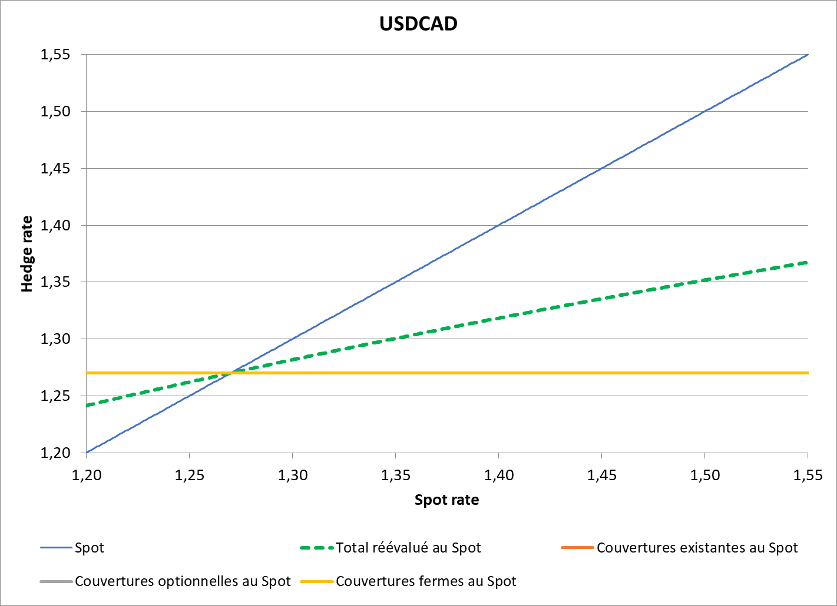
Sensitivity USDCAD

Slide 10
Detailed analysis
by currency

Slide 11
CADJPY - Historical & Planned

Slide 12
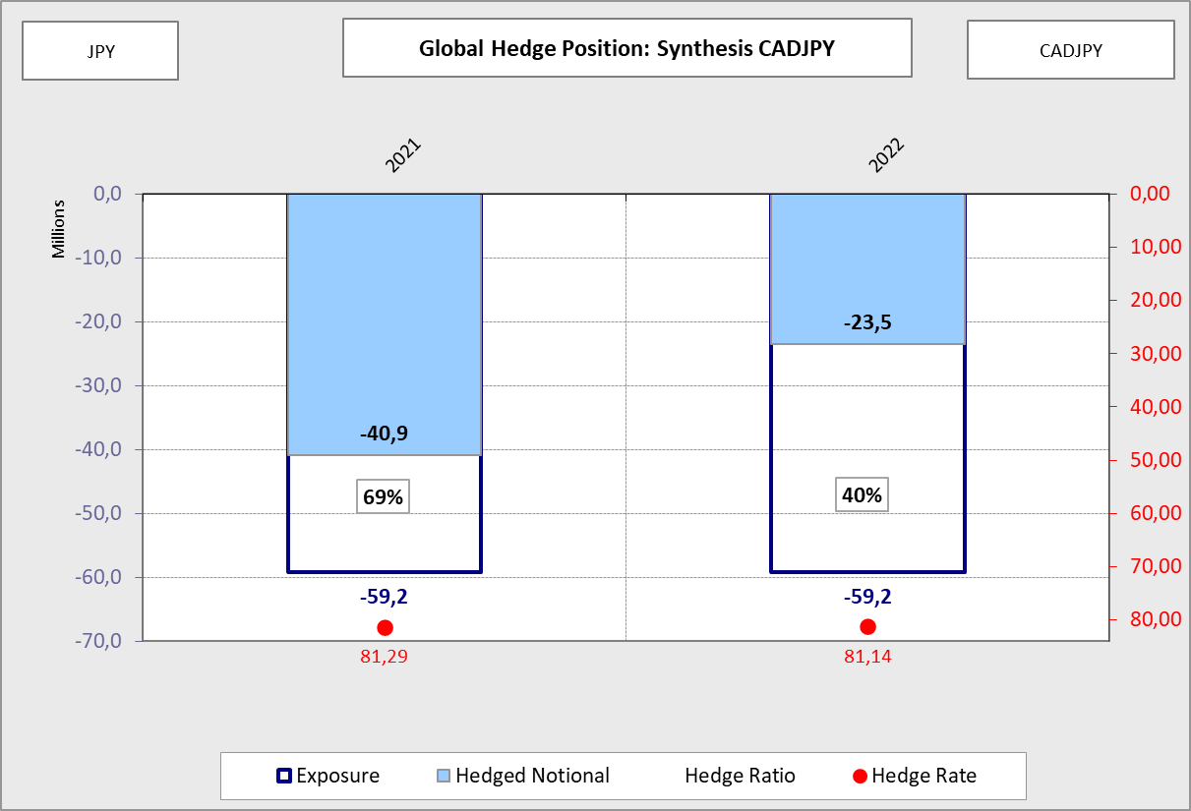
CADJPY - Synthesis

Slide 13
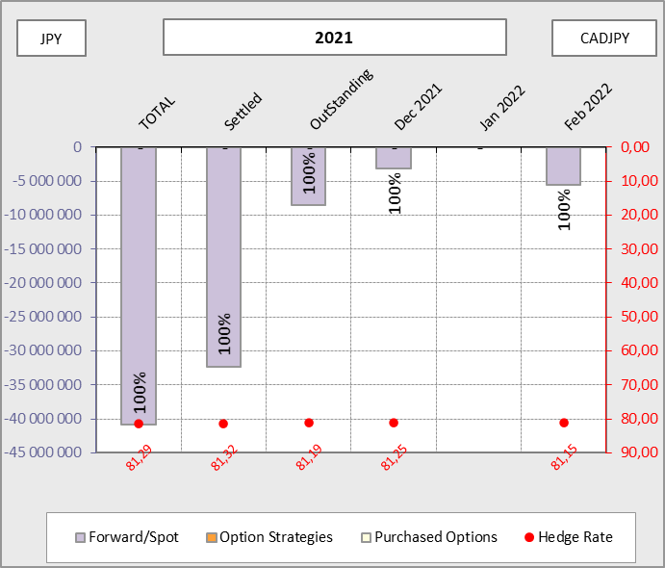
CADJPY - 2021

Slide 14
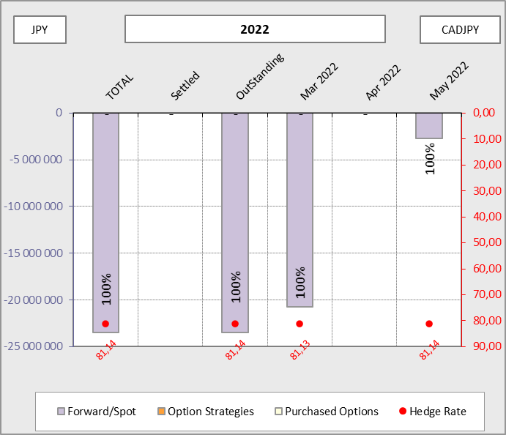
CADJPY - 2022

Slide 15
EURGBP - Historical & Planned

Slide 16
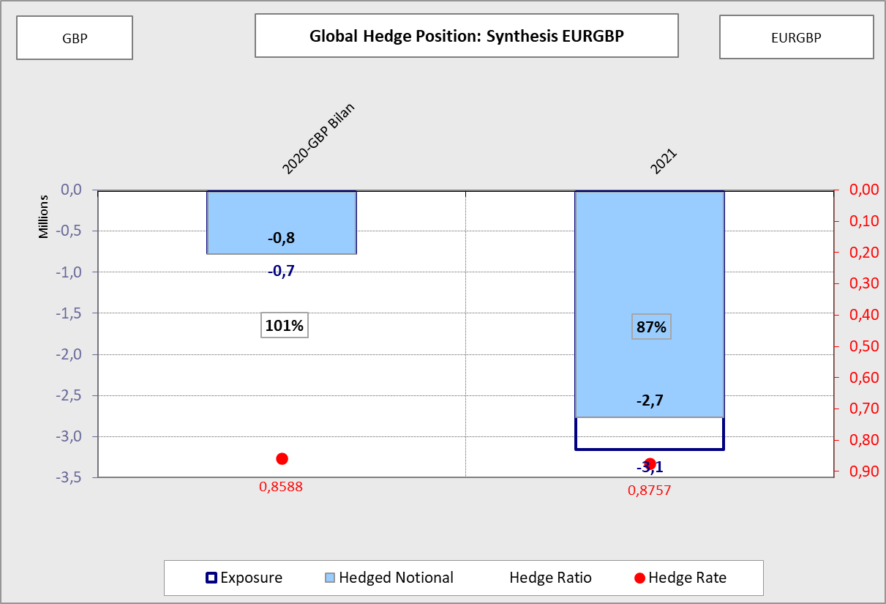
EURGBP - Synthesis

Slide 17
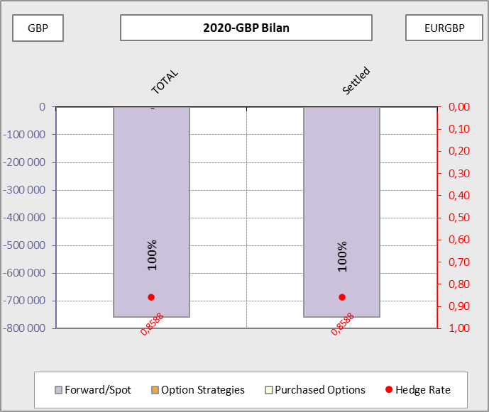
EURGBP - 2020-GBP Bilan

Slide 18
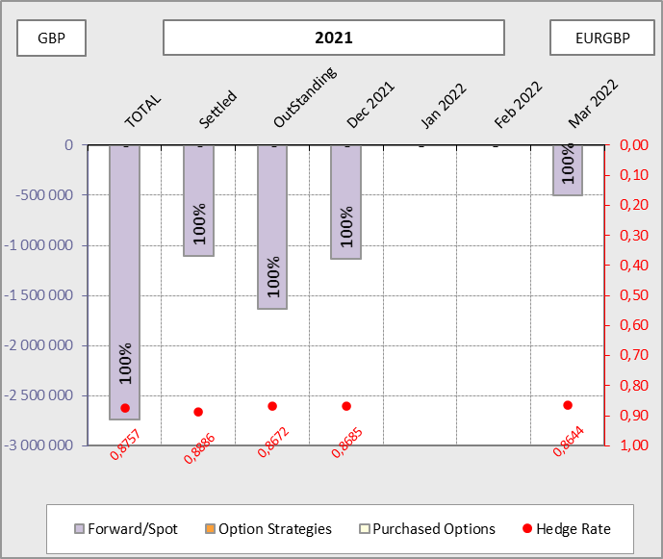
EURGBP - 2021

Slide 19
EURUSD - Historical & Planned

Slide 20
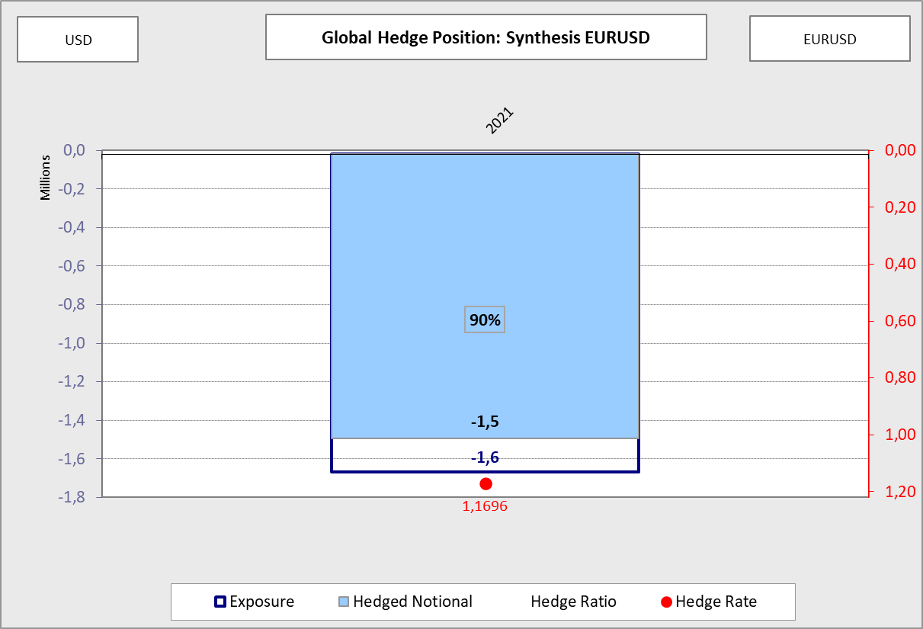
EURUSD - Synthesis

Slide 21
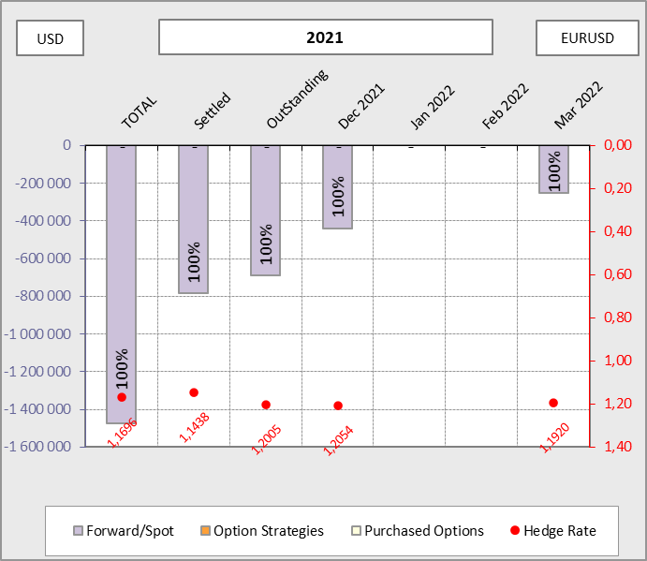
EURUSD - 2021

Slide 22
USDCAD - Historical & Planned

Slide 23
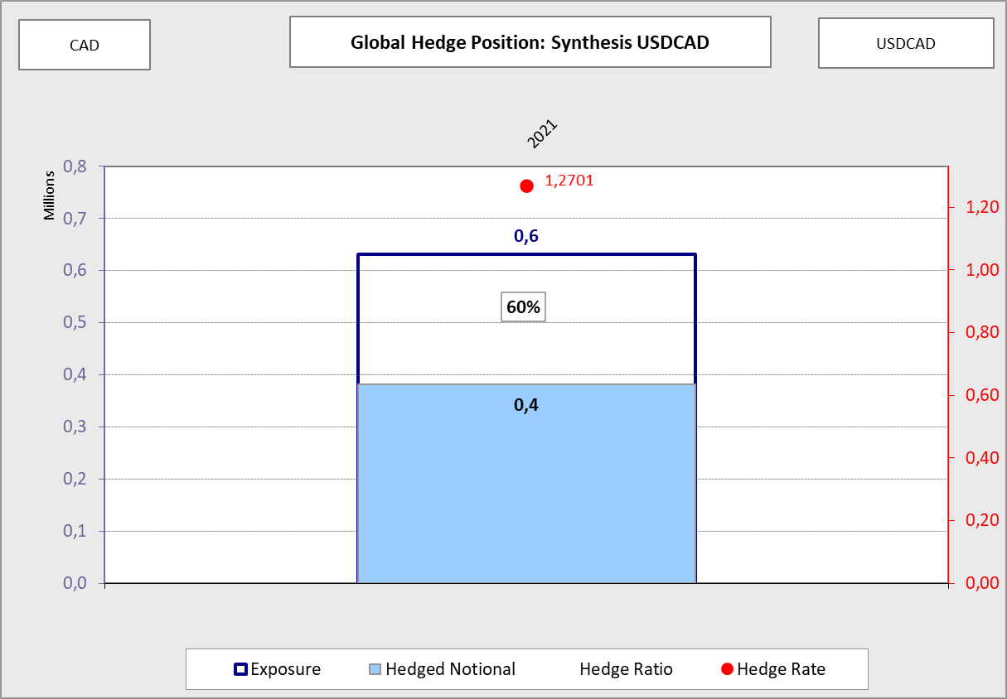
USDCAD - Synthesis

Slide 24
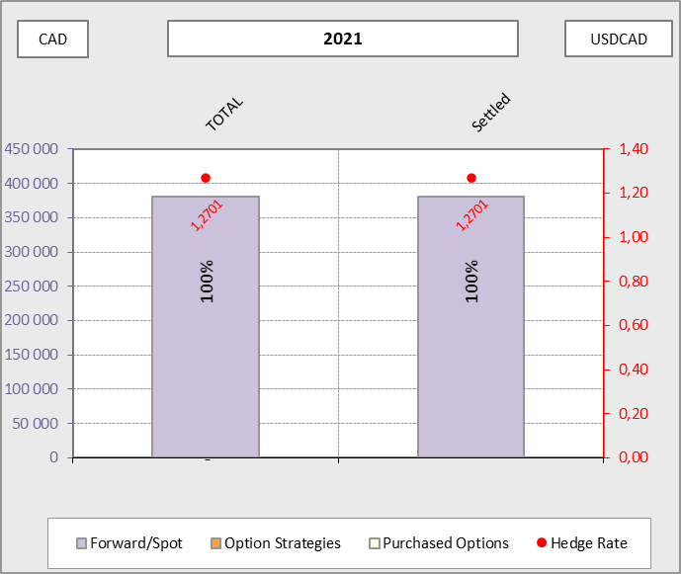
USDCAD - 2021

Slide 25
Internal GHP

Slide 26
Hedging Summary - 2021
EURUSD |  | Hedge Reference |  | Hedged notional | Exposure (USD) |  | Hedge Ratio |  | Budget 2020 |  | Hedge Rate |  | Hedging performance
Groupe Socomore |  | 2021 |  | 368 646 | 375 000 |  | 98% |  | 1,200 |  | 1,17 |  | 7 979
Socomore Ireland |  | 2021 |  | 1 354 880 | 1 425 069 |  | 95% |  | 1,200 |  | 1,17 |  | 29 325
Socomore France |  | 2021 |  | -248 526 | -152 237 |  | 163% |  | NA |  | NA |  | -5 379
Total |  | 2021 |  | 1 475 000 | 1 647 832 |  | 90% |  | 1,200 |  | 1,17 |  | 31 925
EURGBP |  | Hedge Reference |  | Hedged notional | Exposure (GBP) |  | Hedge Ratio |  | Budget 2020 |  | Hedge Rate |  | Hedging performance
Socomore France |  | 2021 |  | 1 052 727 | 1 321 165 |  | 80% |  | 0,890 |  | 0,876 |  | 19 314
Socomore Ireland |  | 2021 |  | 1 688 945 | 1 816 346 |  | 93% |  | 0,890 |  | 0,876 |  | 30 987
Total |  | 2021 |  | 2 741 672 | 3 137 511 |  | 87% |  | 0,890 |  | 0,876 |  | 50 301
USDCAD |  | Hedge Reference |  | Hedged notional | Exposure (CAD) |  | Hedge Ratio |  | Budget 2020 |  | Hedge Rate |  | Hedging performance
Socomore CAD |  | 2021 |  | 381 040 | 631 125 |  | 60% |  | 1,275 |  | 1,270 |  | -1 145
Total |  | 2021 |  | 381 040 | 631 125 |  | 60% |  | 1,275 |  | 1,270 |  | -1 145
CADJPY |  | Hedge Reference |  | Hedged notional | Exposure (JPY) |  | Hedge Ratio |  | Budget 2020 |  | Hedge Rate |  | Hedging performance
Socomore CAD |  | 2021 |  | 40 888 052 | 59 212 495 |  | 69% |  | 81,500 |  | 81,291 |  | 1 293
Total |  | 2021 |  | 40 888 052 | 59 212 495 |  | 69% |  | 81,500 |  | 81,291 |  | 1 293

Slide 27
Hedging Summary - 2022
CADJPY |  | Hedge Reference |  | Hedged notional | Exposure (JPY) |  | Hedge Ratio |  | Budget 2020 |  | Hedge Rate |  | Hedging performance
Socomore CAD |  | 2022 |  | 23 515 948 | 59 212 495 |  | 40% |  | 81,500 |  | 81,135 |  | 1 297
Total |  | 2022 |  | 23 515 948 | 59 212 495 |  | 40% |  | 81,500 |  | 81,135 |  | 1 297

Slide 28
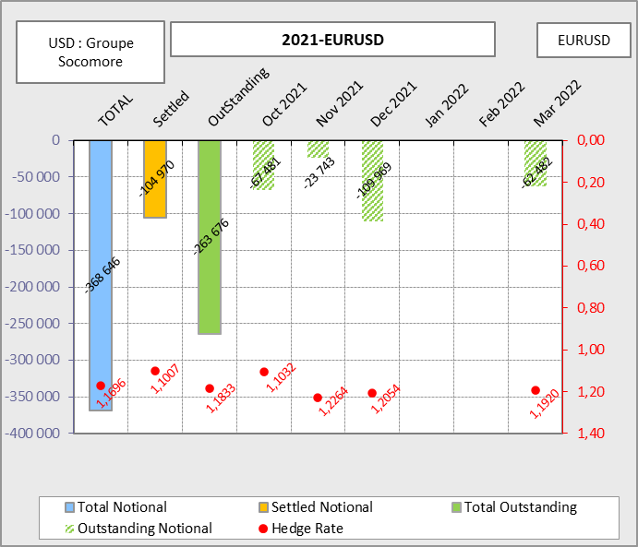
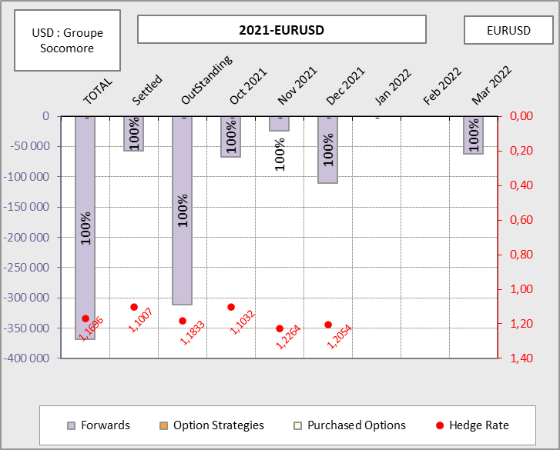
EURUSD - 2021-EURUSD

Slide 29
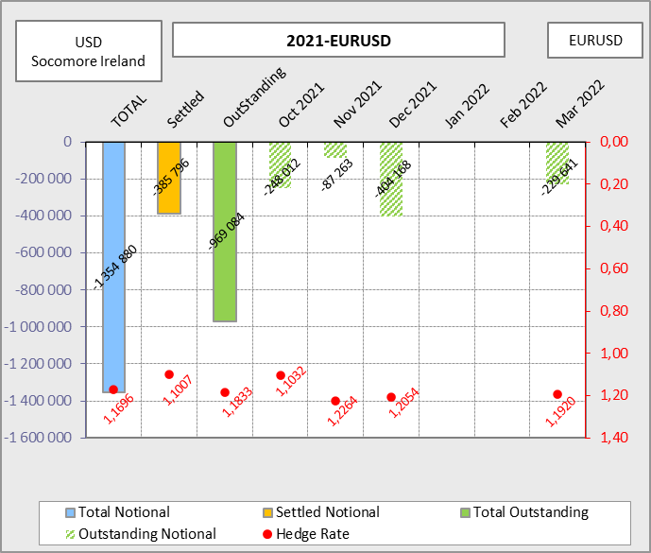
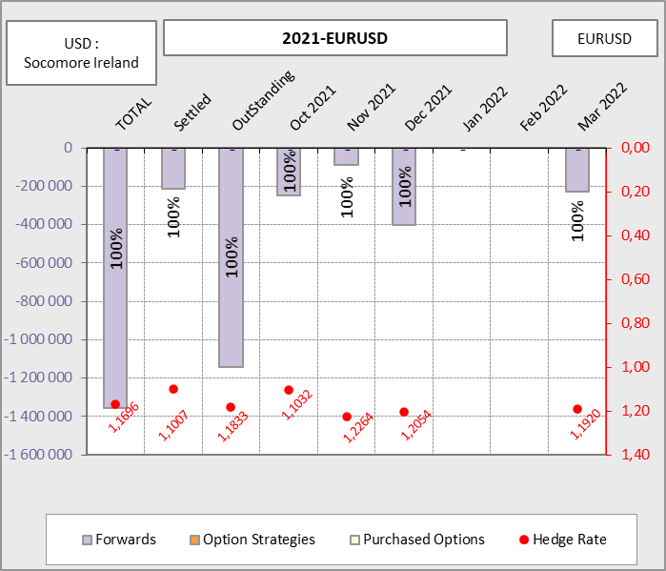
EURUSD - 2021-EURUSD

Slide 30
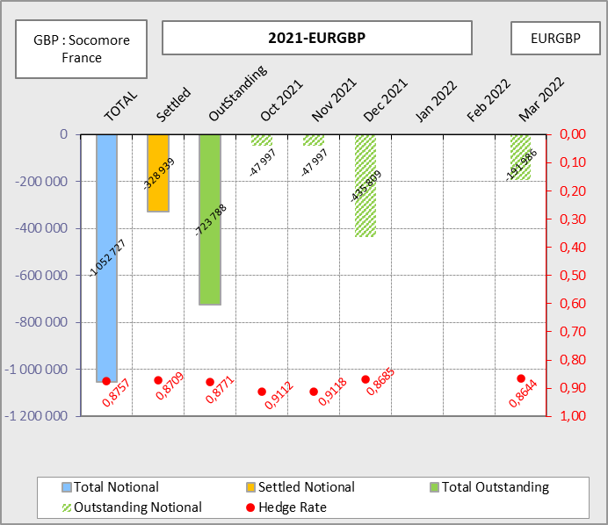
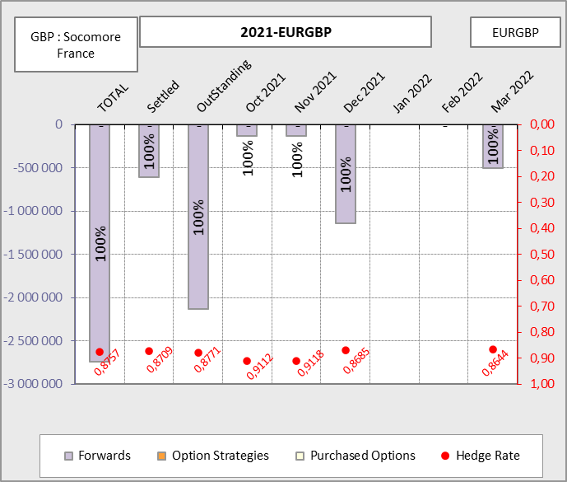
EURGBP - 2021-EURGBP

Slide 31
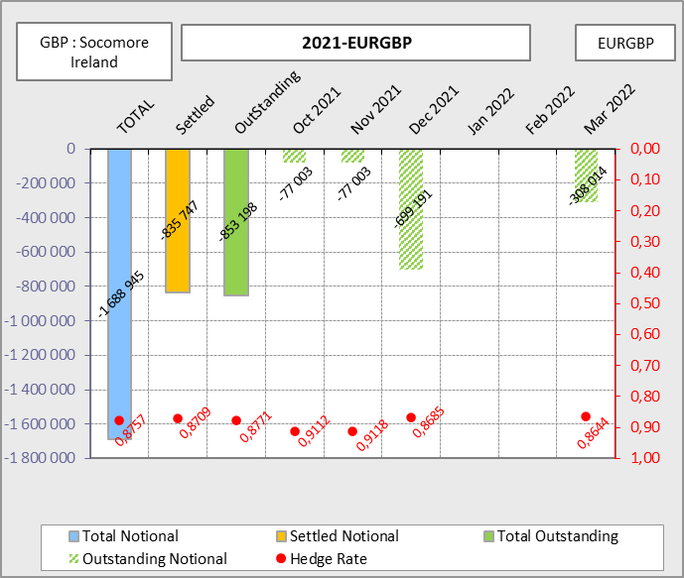
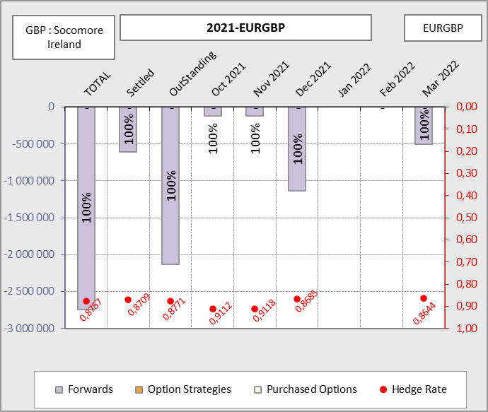
EURGBP - 2021-EURGBP

Slide 32
Hedging Summary - 2020
EURGBP |  | Hedge Reference |  | Hedged notional | Exposure (GBP) |  | Hedge Rate |  | Budget 2020 |  | Hedge Rate |  |  | Hedging performance
Groupe Socomore |  | 2020 - Bilan |  | 176 245 | 176 245 |  | 100% |  | NA |  | 0,8584 |  |  | -
Socomore France |  | 2020 - Bilan |  | 55 757 | 55 757 |  | 100% |  | NA |  | 0,8584 |  |  | -
Socomore Ireland |  | 2020 - Bilan |  | 515 377 | 515 377 |  | 100% |  | NA |  | 0,8584 |  |  | -
Total* |  | 2020 - Bilan |  | 747 379 | 747 379 |  | 100% |  | NA |  | 0,8584 |  |  | -
*A mettre à jour une fois la livraison des flux finaux par les filiales

Slide 33
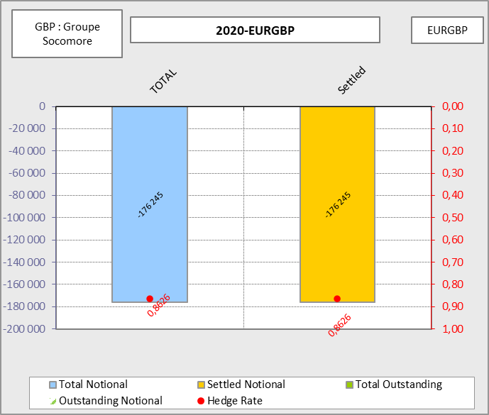
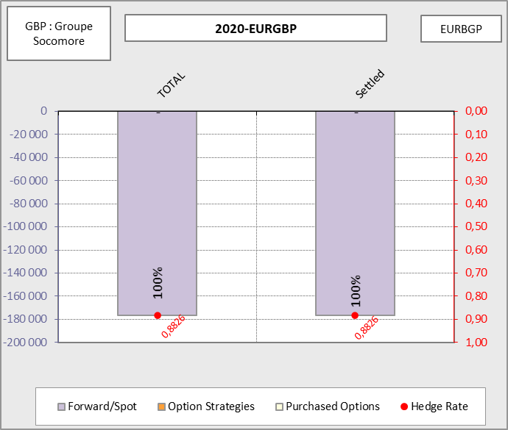
EURGBP - 2020-EURGBP

Slide 34
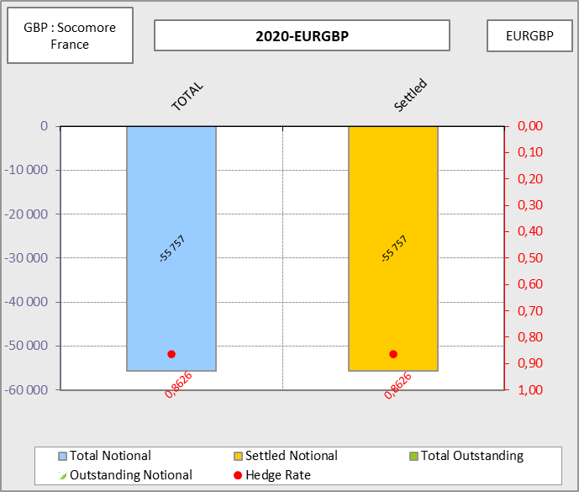
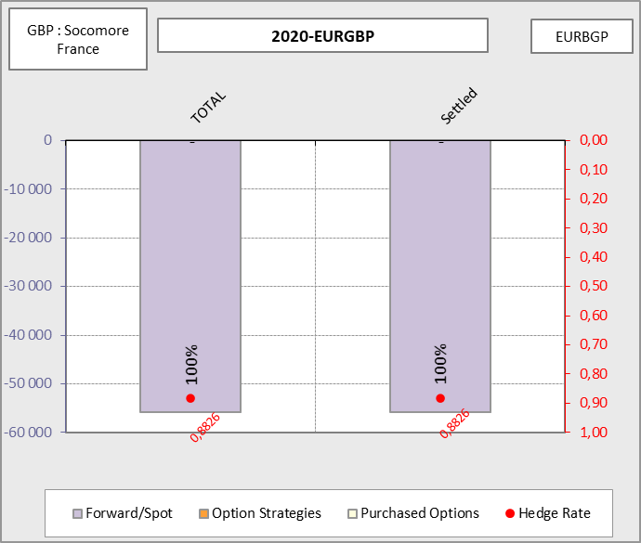
EURGBP - 2020-EURGBP

Slide 35
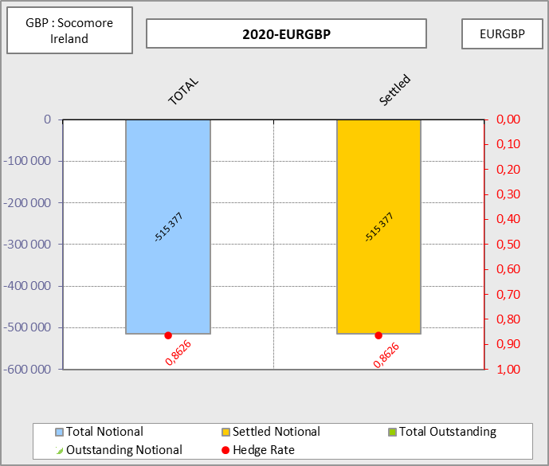
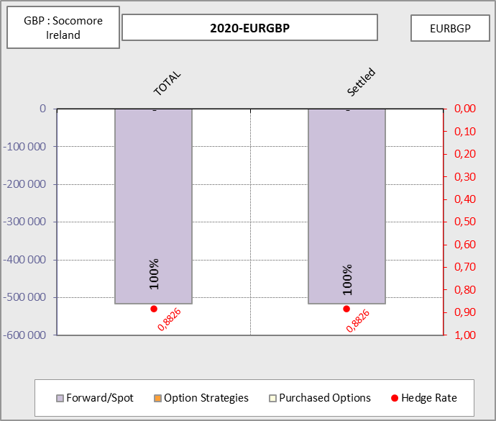
EURGBP - 2020-EURGBP

Slide 36
Internal GHP

Slide 37
Hedging Summary - 2021
EURUSD |  | Hedge Reference |  | Hedged notional | Exposure (USD) |  | Hedge Ratio |  | Budget 2020 |  | Hedge Rate |  | Hedging performance
Groupe Socomore |  | 2021 |  | 368 646 | 375 000 |  | 98% |  | 1,200 |  | 1,17 |  | 7 979
Socomore Ireland |  | 2021 |  | 1 354 880 | 1 425 069 |  | 95% |  | 1,200 |  | 1,17 |  | 29 325
Socomore France |  | 2021 |  | -248 526 | -152 237 |  | 163% |  | NA |  | NA |  | -5 379
Total |  | 2021 |  | 1 475 000 | 1 647 832 |  | 90% |  | 1,200 |  | 1,17 |  | 31 925
EURGBP |  | Hedge Reference |  | Hedged notional | Exposure (GBP) |  | Hedge Ratio |  | Budget 2020 |  | Hedge Rate |  | Hedging performance
Socomore France |  | 2021 |  | 1 052 727 | 1 321 165 |  | 80% |  | 0,890 |  | 0,876 |  | 19 314
Socomore Ireland |  | 2021 |  | 1 688 945 | 1 816 346 |  | 93% |  | 0,890 |  | 0,876 |  | 30 987
Total |  | 2021 |  | 2 741 672 | 3 137 511 |  | 87% |  | 0,890 |  | 0,876 |  | 50 301
USDCAD |  | Hedge Reference |  | Hedged notional | Exposure (CAD) |  | Hedge Ratio |  | Budget 2020 |  | Hedge Rate |  | Hedging performance
Socomore CAD |  | 2021 |  | 381 040 | 631 125 |  | 60% |  | 1,275 |  | 1,270 |  | -1 145
Total |  | 2021 |  | 381 040 | 631 125 |  | 60% |  | 1,275 |  | 1,270 |  | -1 145
CADJPY |  | Hedge Reference |  | Hedged notional | Exposure (JPY) |  | Hedge Ratio |  | Budget 2020 |  | Hedge Rate |  | Hedging performance
Socomore CAD |  | 2021 |  | 40 888 052 | 59 212 495 |  | 69% |  | 81,500 |  | 81,291 |  | 1 293
Total |  | 2021 |  | 40 888 052 | 59 212 495 |  | 69% |  | 81,500 |  | 81,291 |  | 1 293

Slide 38
Hedging Summary - 2022
CADJPY |  | Hedge Reference |  | Hedged notional | Exposure (JPY) |  | Hedge Ratio |  | Budget 2020 |  | Hedge Rate |  | Hedging performance
Socomore CAD |  | 2022 |  | 23 515 948 | 59 212 495 |  | 40% |  | 81,500 |  | 81,135 |  | 1 297
Total |  | 2022 |  | 23 515 948 | 59 212 495 |  | 40% |  | 81,500 |  | 81,135 |  | 1 297

Slide 39
EURUSD - 2021-EURUSD

Slide 40
EURUSD - 2021-EURUSD

Slide 41
EURGBP - 2021-EURGBP

Slide 42
EURGBP - 2021-EURGBP

Slide 43
Hedging Summary - 2020
EURGBP |  | Hedge Reference |  | Hedged notional | Exposure (GBP) |  | Hedge Rate |  | Budget 2020 |  | Hedge Rate |  |  | Hedging performance
Groupe Socomore |  | 2020 - Bilan |  | 176 245 | 176 245 |  | 100% |  | NA |  | 0,8584 |  |  | -
Socomore France |  | 2020 - Bilan |  | 55 757 | 55 757 |  | 100% |  | NA |  | 0,8584 |  |  | -
Socomore Ireland |  | 2020 - Bilan |  | 515 377 | 515 377 |  | 100% |  | NA |  | 0,8584 |  |  | -
Total* |  | 2020 - Bilan |  | 747 379 | 747 379 |  | 100% |  | NA |  | 0,8584 |  |  | -
*A mettre à jour une fois la livraison des flux finaux par les filiales

Slide 44
EURGBP - 2020-EURGBP

Slide 45
EURGBP - 2020-EURGBP

Slide 46
EURGBP - 2020-EURGBP

Slide 47
KERIUS Finance Suisse SARL
Chemin de Blandonnet 2,
1214 Vernier - Genève, Suisse
Tel : + 41 22 566 40 52
RC Genève, numéro fédéral: CH-660-2330011-1
KERIUS Finance SAS
17 rue Dupin,
75006 Paris, France
Tel: +33 1 83 62 27 61
RC Paris: 520 300 948
Immatriculé au Registre Unique des Intermédiaire en Assurance, Banque et Finance (ORIAS) sous le n°13000716 au titre des activités de Conseiller en Investissements Financiers, enregistré auprès de l’Association Nationale des Conseils Financiers-CIF, association agréée par l’Autorité des Marchés Financiers .
www.kerius-finance.com
Sébastien Rouzaire
s.rouzaire@kerius-finance.com
2013-12-04

Slide 48
AVERTISSEMENT - DISCLAIMER
Ce document a été préparé à l’usage des services financiers du Client. Ce document ou son contenu ne doivent pas être communiqués ou diffusés en externe sans l’accord préalable écrit de KERIUS FINANCE .
Pour ce document, KERIUS FINANCE a été amenée à utiliser des informations et données chiffrées fournies par le Client. KERIUS FINANCE a pris ces données en compte sans réaliser de procédure d’audit et n’émettra en conséquence aucune opinion sur leur fiabilité. Ce document ne constitue pas une documentation contractuelle des transactions éventuellement décrites, ni une recommandation ou une sollicitation de mettre en place les transactions décrites. Tout Client intéressé par ce type de transactions ou procédure doit mener ses propres analyses pour vérifier l’adéquation à ses besoins, ainsi que les conséquences, notamment fiscales et comptables. Il lui appartient également de prendre les dispositions nécessaires à la mise en œuvre des décisions qu’il aura prises.
Ni KERIUS FINANCE ou ses administrateurs ou employés ne pourront être tenus responsables des conséquences de l’utilisation de ce document ou de la mise en place, totale ou partielle, par le client, des idées ou opérations décrites.
This document has been prepared for the Finance department of the Client. It must not be communicated or published externally without prior written consent of KERIUS FINANCE
For this document, KERIUS FINANCE used information and data provided by the Client. The Client agrees that KERIUS FINANCE took this information into account without auditing them or checking their accuracy and, as a consequence, without producing any opinion on their reliability. Please note that this document does not constitute a contractual documentation of the transactions or processes that may be described, nor a recommendation or solicitation to enter into the transactions or processes described herein. If the Client is interested in setting up this type of transactions or processes, the Client should conduct his own analysis of the suitability to his needs. The Client must also verify the consequences of his decisions, including accounting and fiscal aspects. The Client is also responsible for the implementation of his decisions.
Neither KERIUS FINANCE nor its directors and employees accept liability for any loss or damage resulting from the use of this document and expressly excludes all liability in respect of any implication of the described ideas or transactions on the Client’s own specific particulars.
2013-01-01

