Slide 1

Global Hedge Position
31/12/2021
KERIUS Finance SAS
Conseiller en Investissements Financiers
Membre de l’ANACOFI CIF- Association agréée par l’AMF - ORIAS N° 13000716

Slide 2
Contents
Global view
  Hedging Summary
  Hedging Performance
  Options premium synthesis (if any)
  Sensitivity
  Detailed analysis by currency
    Historical & forward curves vs budget & hedge rates
    Hedge Schedule
    Hedging Analysis

Slide 3
Global view

Slide 4
Hedging Summary

Slide 5
Hedging Performance

Slide 6
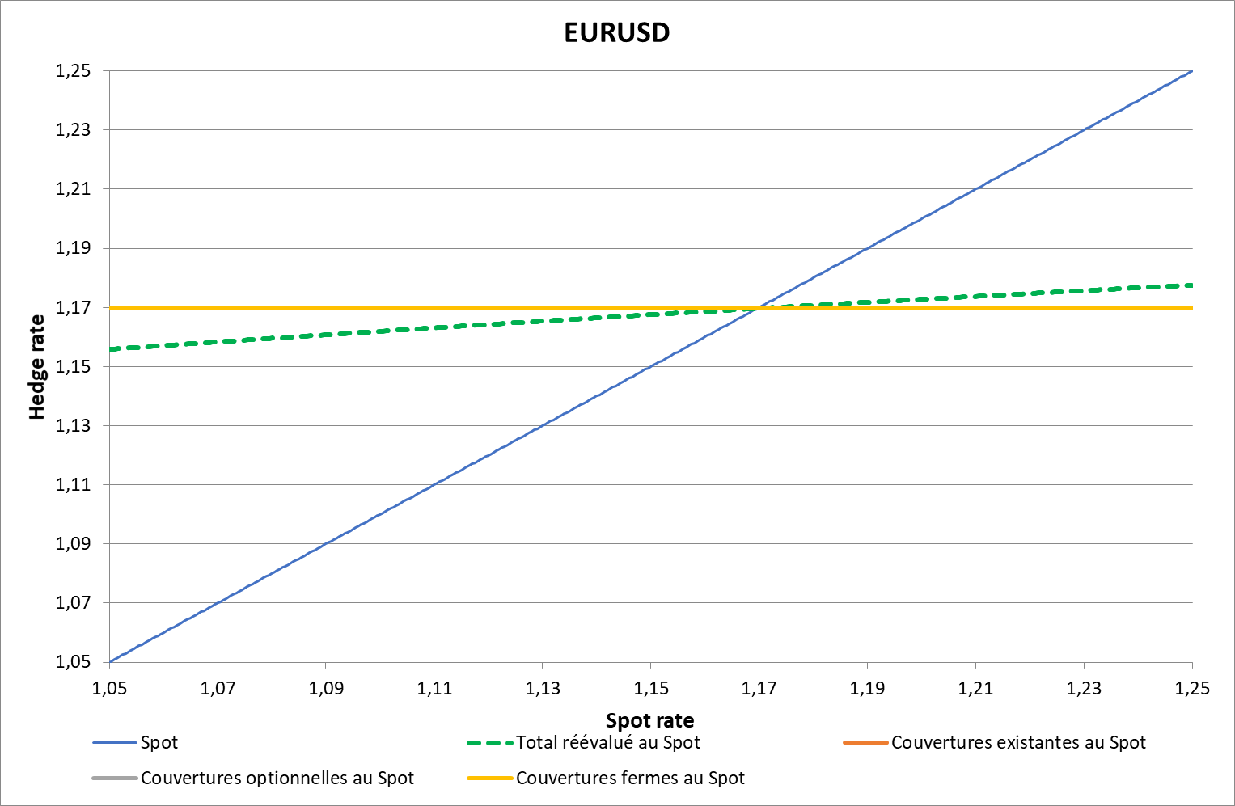
Sensitivity EURUSD

Slide 7
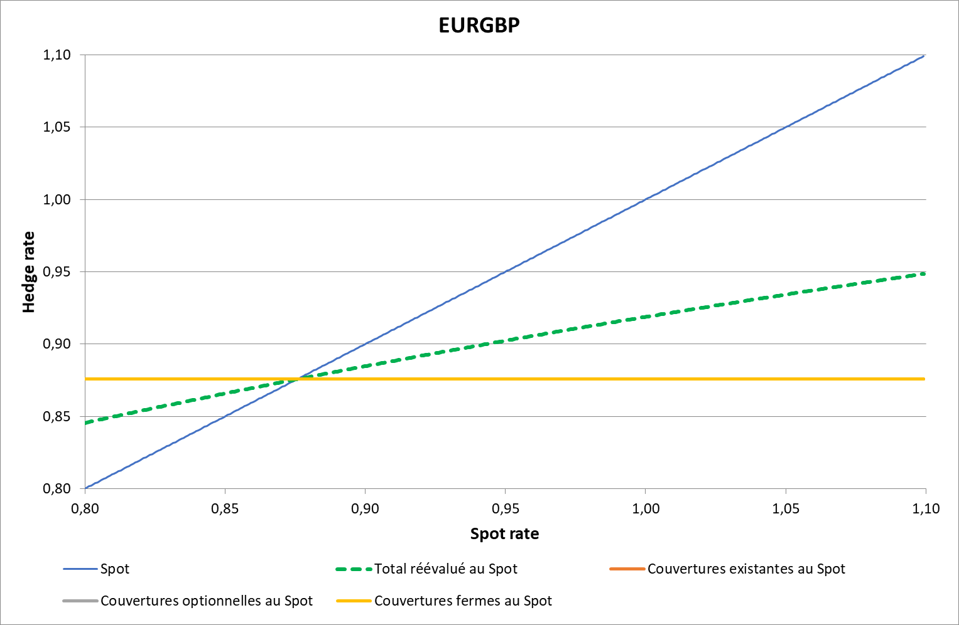
Sensitivity EURGBP

Slide 8
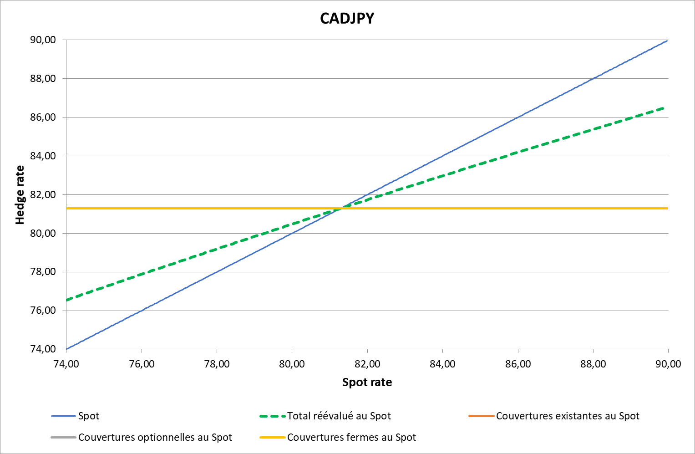
Sensitivity CADJPY

Slide 9
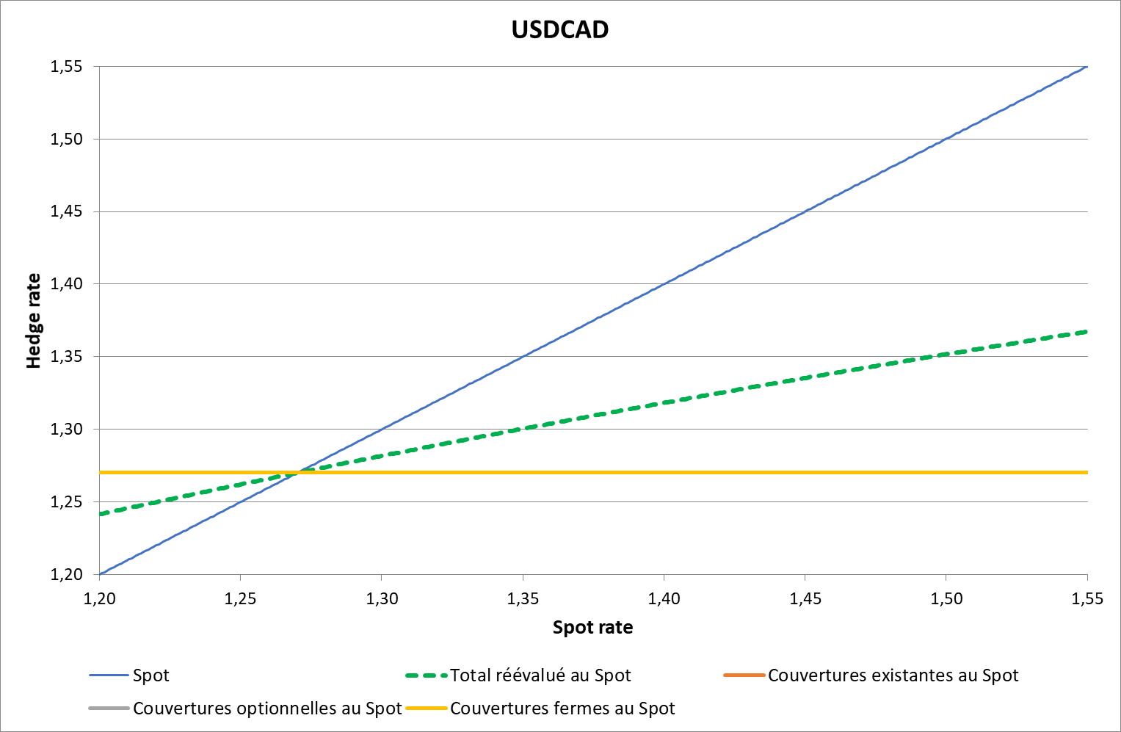
Sensitivity USDCAD

Slide 10
Detailed analysis
by currency

Slide 11
CADJPY - Historical & Planned

Slide 12
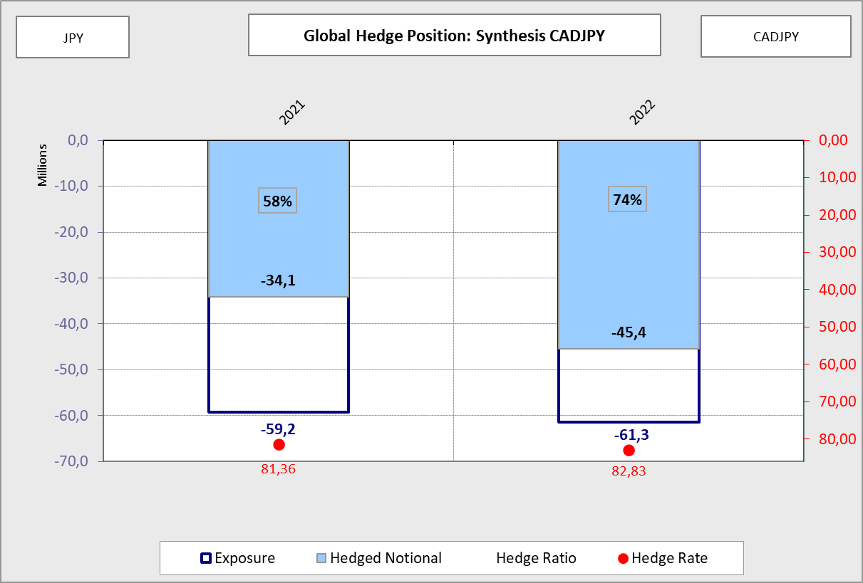
CADJPY - Synthesis

Slide 13
CADJPY - 2021

Slide 14
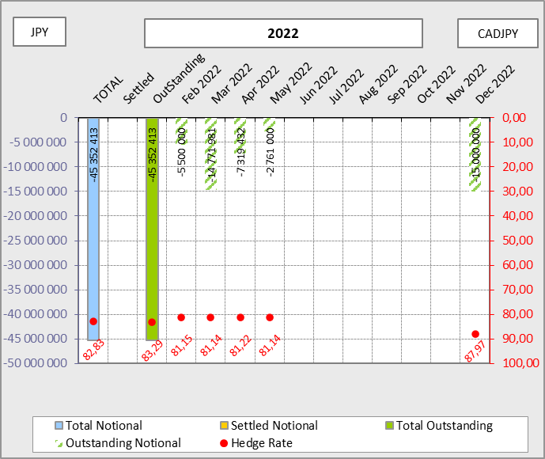
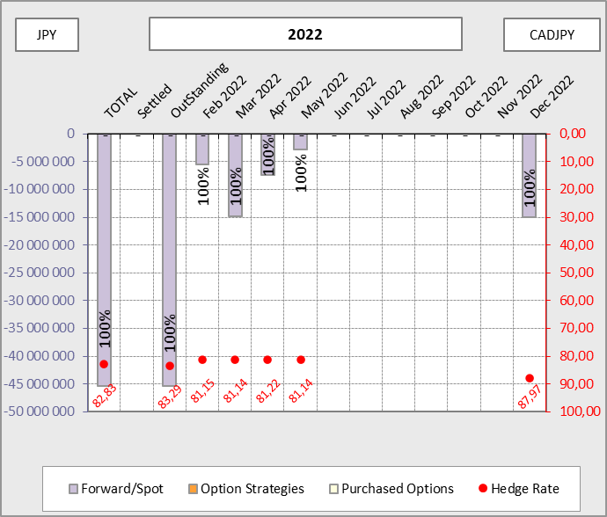
CADJPY - 2022

Slide 15
EURGBP - Historical & Planned

Slide 16
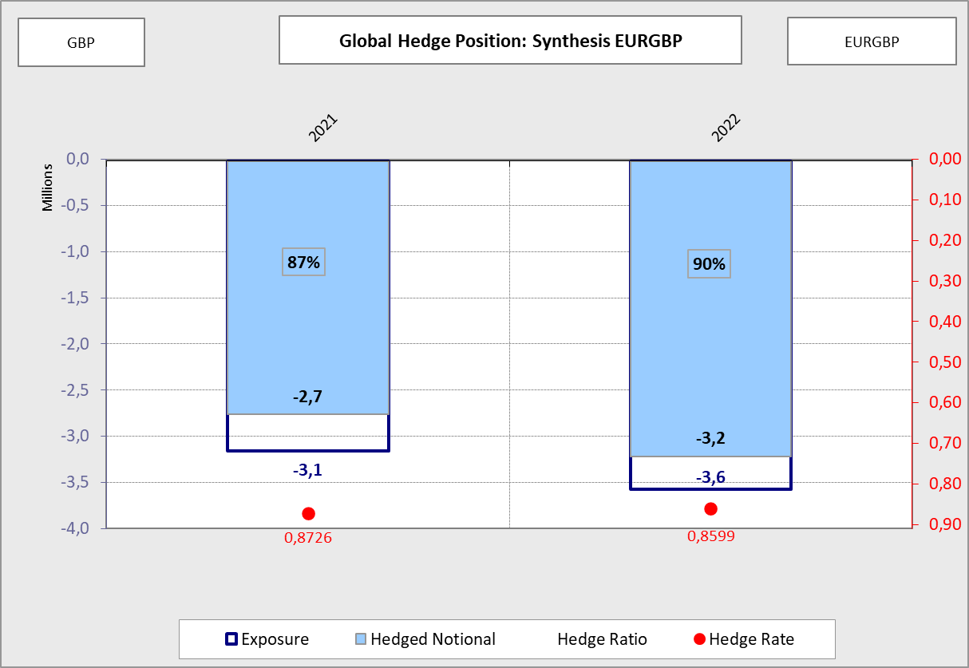
EURGBP - Synthesis

Slide 17
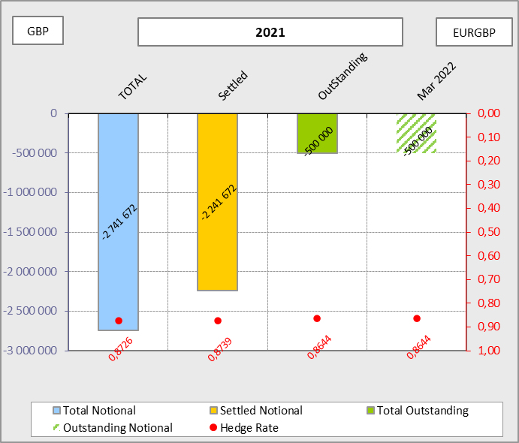
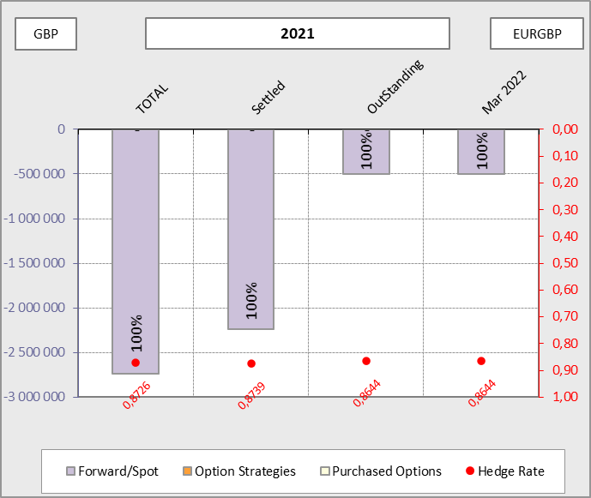
EURGBP - 2021

Slide 18
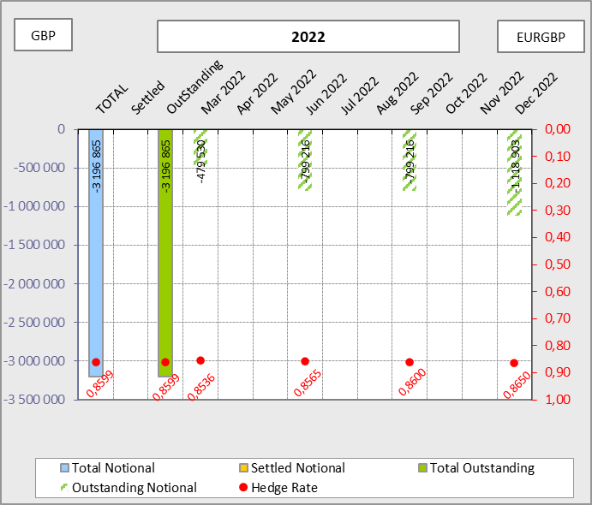
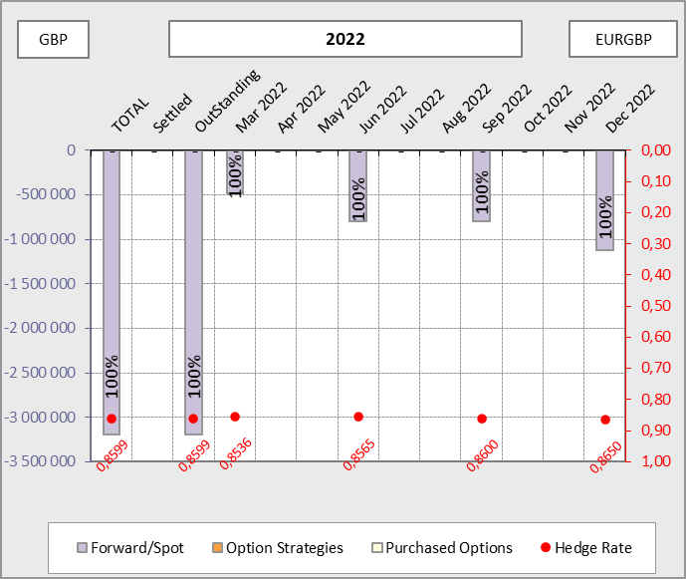
EURGBP - 2022

Slide 19
EURUSD - Historical & Planned

Slide 20
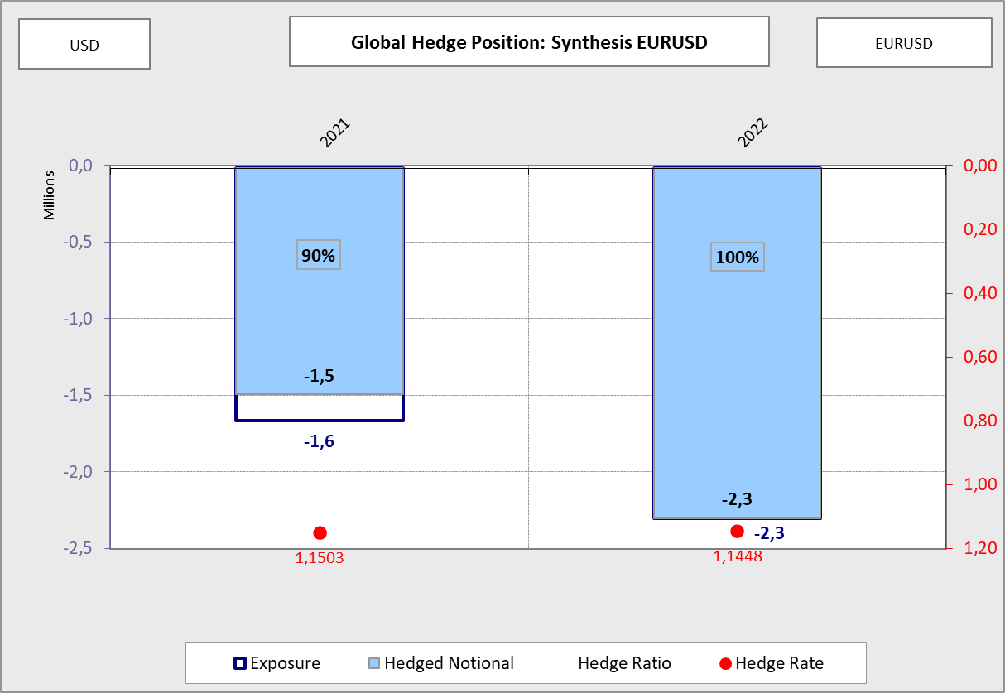
EURUSD - Synthesis

Slide 21
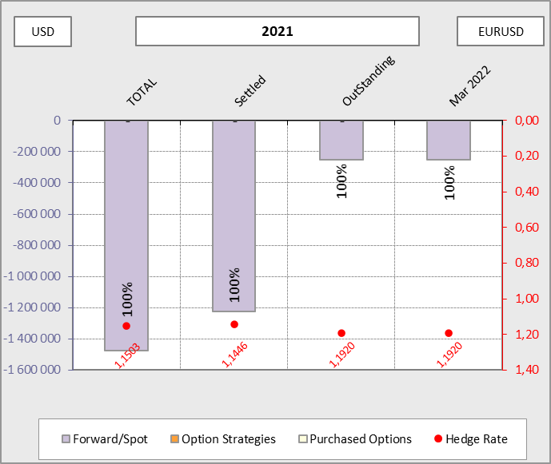
EURUSD - 2021

Slide 22
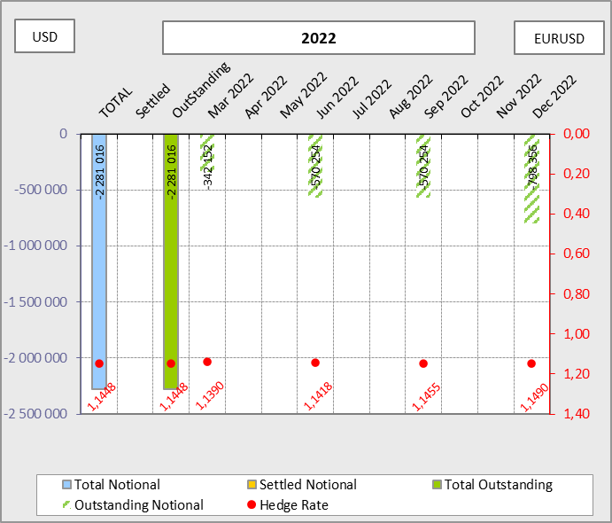
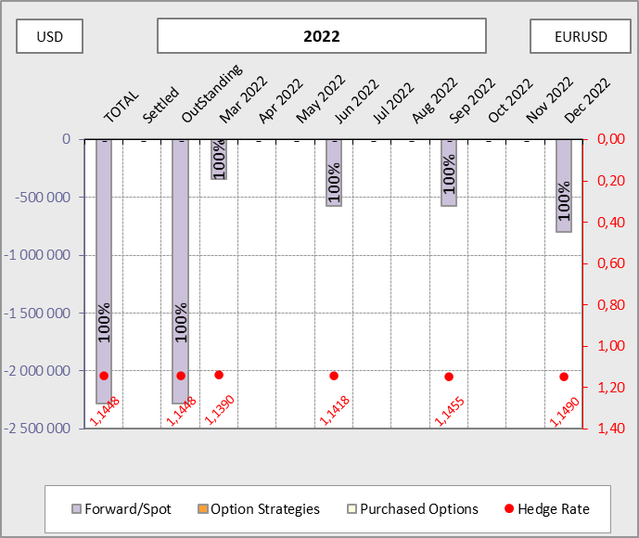
EURUSD - 2022

Slide 23
USDCAD - Historical & Planned

Slide 24
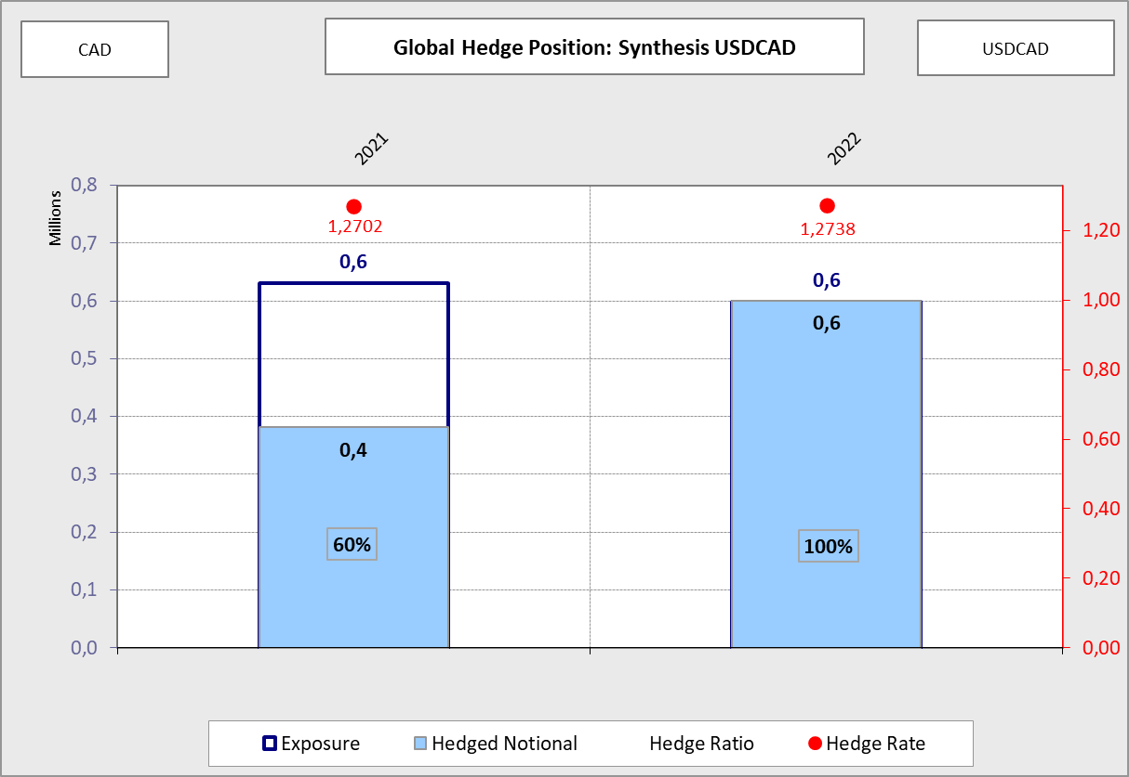
USDCAD - Synthesis

Slide 25
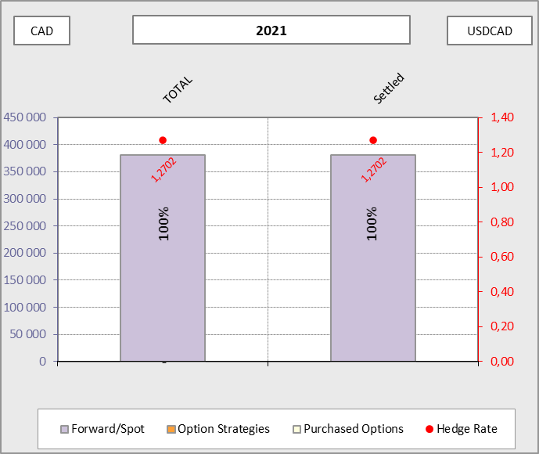
USDCAD - 2021

Slide 26
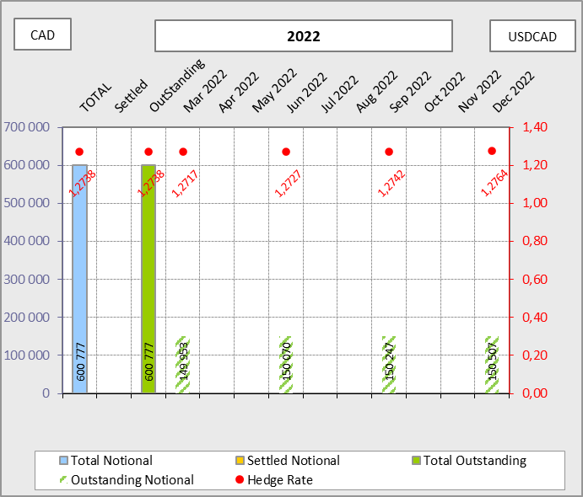
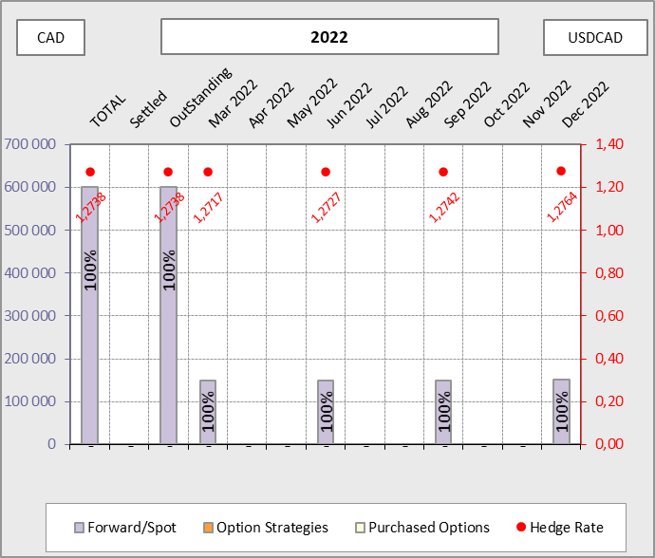
USDCAD - 2022

Slide 27
Internal GHP

Slide 28
Hedging Summary - 2021
EURUSD |  | Hedge Reference |  | Hedged notional | Exposure (USD) |  | Hedge Ratio |  | Budget 2021 |  | Hedge Rate |  | Hedging performance
Groupe Socomore |  | 2021 |  | 368 646 | 375 000 |  | 98% |  | 1,200 |  | 1,1503 |  | 13 268
Socomore Ireland |  | 2021 |  | 1 354 880 | 1 425 069 |  | 95% |  | 1,200 |  | 1,1503 |  | 48 763
Socomore France |  | 2021 |  | -248 526 | -152 237 |  | 163% |  | NA |  | NA |  | -8 945
Total |  | 2021 |  | 1 475 000 | 1 647 832 |  | 90% |  | 1,200 |  | 1,1503 |  | 53 087
EURGBP |  | Hedge Reference |  | Hedged notional | Exposure (GBP) |  | Hedge Ratio |  | Budget 2021 |  | Hedge Rate |  | Hedging performance
Socomore France |  | 2021 |  | 1 052 727 | 1 321 165 |  | 80% |  | 0,890 |  | 0,8726 |  | 23 592
Socomore Ireland |  | 2021 |  | 1 688 945 | 1 816 346 |  | 93% |  | 0,890 |  | 0,8726 |  | 37 849
Total |  | 2021 |  | 2 741 672 | 3 137 511 |  | 87% |  | 0,890 |  | 0,8726 |  | 61 441
USDCAD |  | Hedge Reference |  | Hedged notional | Exposure (CAD) |  | Hedge Ratio |  | Budget 2021 |  | Hedge Rate |  | Hedging performance
Socomore CAD |  | 2021 |  | 381 040 | 631 125 |  | 60% |  | 1,275 |  | 1,2702 |  | -1 129
Total |  | 2021 |  | 381 040 | 631 125 |  | 60% |  | 1,275 |  | 1,2702 |  | -1 129
CADJPY |  | Hedge Reference |  | Hedged notional | Exposure (JPY) |  | Hedge Ratio |  | Budget 2021 |  | Hedge Rate |  | Hedging performance
Socomore CAD |  | 2021 |  | 34 051 587 | 59 212 495 |  | 58% |  | 81,500 |  | 81,3609 |  | 714
Total |  | 2021 |  | 34 051 587 | 59 212 495 |  | 58% |  | 81,500 |  | 81,3609 |  | 714

Slide 29
Hedging Summary - 2022
EURUSD |  | Hedge Reference |  | Hedged notional | Exposure (USD) |  | Hedge Ratio |  | Budget 2022 |  | Hedge Rate |  | Hedging performance
Groupe Socomore |  | 2022 |  | 741 210 | 741 210 |  | 100% |  | 1,135 |  | 1,1448 |  | -5 598
Socomore Ireland |  | 2022 |  | 1 666 767 | 1 666 767 |  | 100% |  | 1,135 |  | 1,1448 |  | -12 588
Socomore France |  | 2022 |  | 223 040 | 223 040 |  | 100% |  | 1,135 |  | 1,1448 |  | -1 684
BABBCO |  | 2022 |  | -350 000 | -350 000 |  | 100% |  | 1,135 |  | NA |  | 2 643
Total |  | 2022 |  | 2 281 016 | 2 281 017 |  | 100% |  | 1,135 |  | 1,1448 |  | -17 227
EURGBP |  | Hedge Reference |  | Hedged notional | Exposure (GBP) |  | Hedge Ratio |  | Budget 2022 |  | Hedge Rate |  | Hedging performance
Groupe Socomore |  | 2022 |  | 0 | 0 |  | NA |  | 0,850 |  | 0,8599 |  | 0
Socomore France |  | 2022 |  | 1 388 173 | 1 542 414 |  | 90% |  | 0,850 |  | 0,8599 |  | -18 791
Socomore Ireland |  | 2022 |  | 1 808 693 | 2 009 659 |  | 90% |  | 0,850 |  | 0,8599 |  | -24 484
Total |  | 2022 |  | 3 196 866 | 3 552 073 |  | 90% |  | 0,850 |  | 0,8599 |  | -43 275
USDCAD |  | Hedge Reference |  | Hedged notional | Exposure (CAD) |  | Hedge Ratio |  | Budget 2022 |  | Hedge Rate |  | Hedging performance
Socomore CAD |  | 2022 |  | 600 777 | 600 777 |  | 100% |  | 1,270 |  | 1,2738 |  | 1 393
Total |  | 2022 |  | 600 777 | 600 777 |  | 100% |  | 1,270 |  | 1,2738 |  | 1 393
CADJPY |  | Hedge Reference |  | Hedged notional | Exposure (JPY) |  | Hedge Ratio |  | Budget 2022 |  | Hedge Rate |  | Hedging performance
Socomore CAD |  | 2022 |  | 45 352 413 | 61 333 910 |  | 74% |  | 91,000 |  | 82,8314 |  | 49 149
Total |  | 2022 |  | 45 352 413 | 61 333 910 |  | 74% |  | 91,000 |  | 82,8314 |  | 49 149

Slide 30
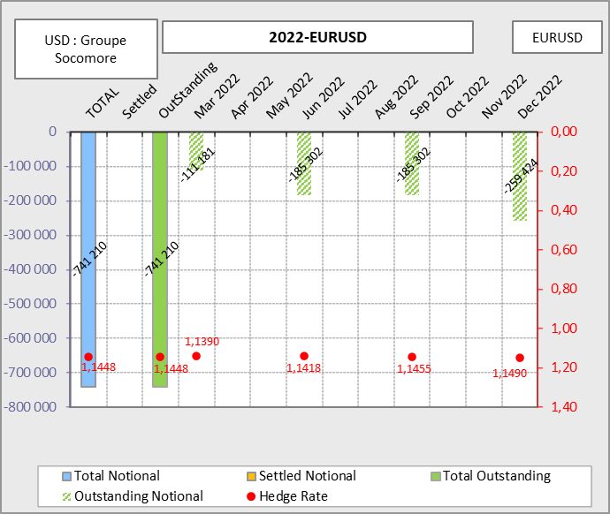
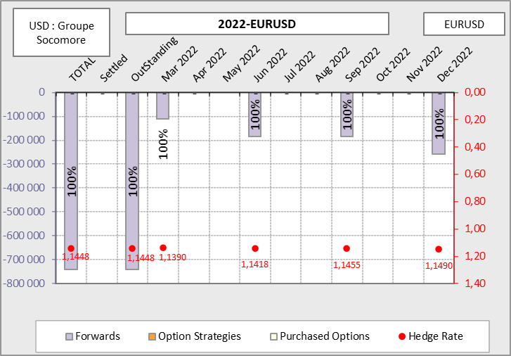
EURUSD – 2022 – Groupe Socomore

Slide 31
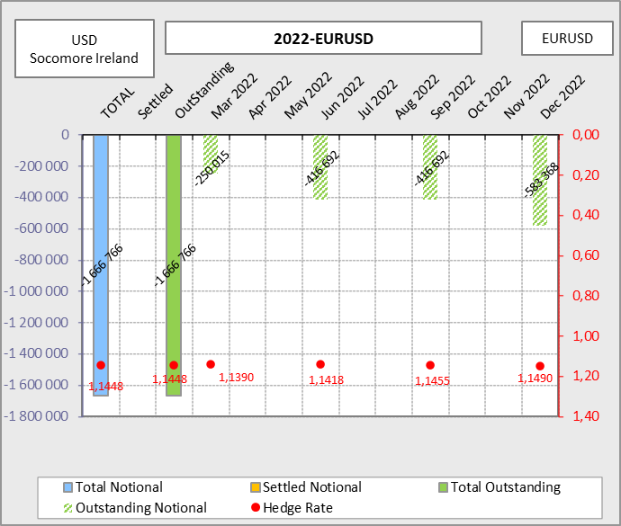
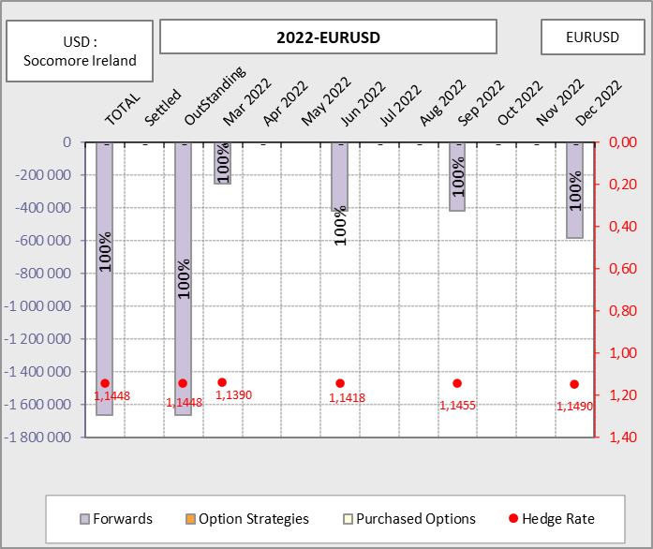
EURUSD – 2022 – Socomore Ireland

Slide 32

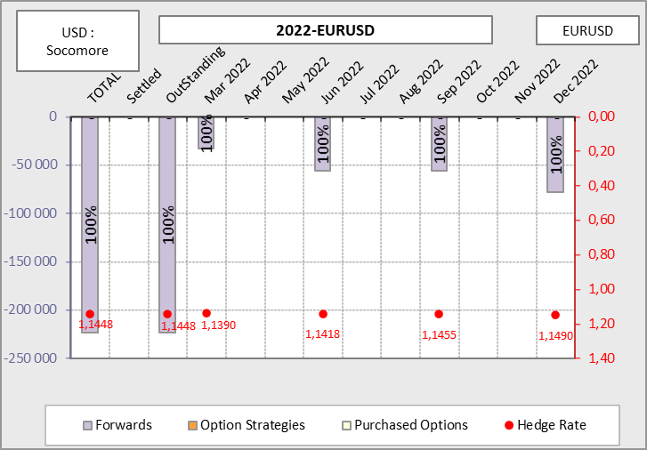
EURUSD – 2022 – Socomore France

Slide 33
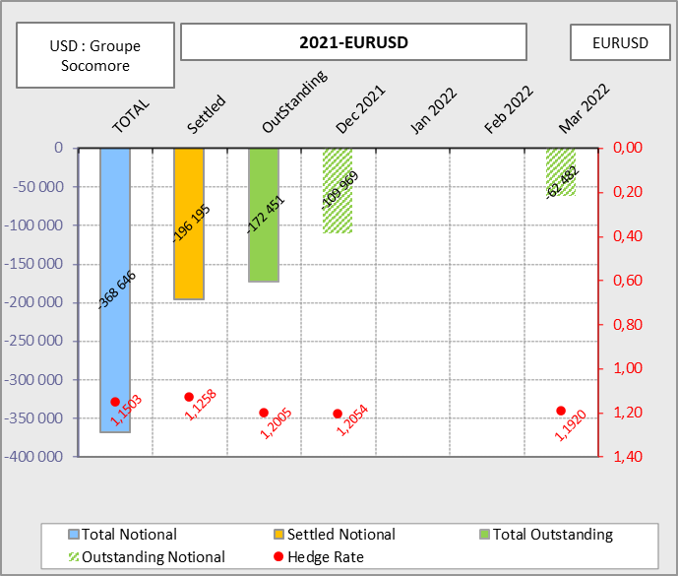
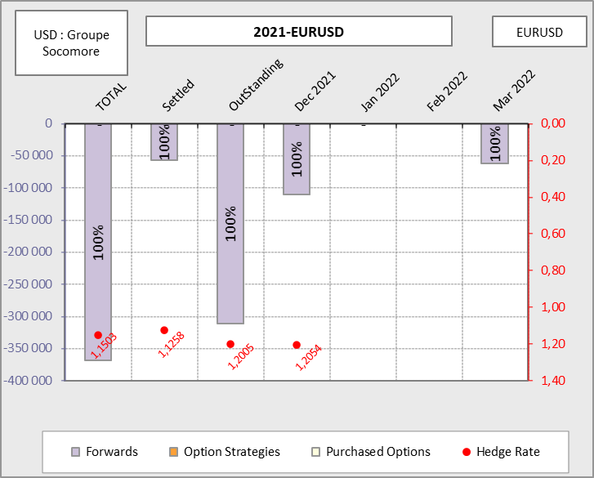
EURUSD – 2021 – Groupe Socomore

Slide 34
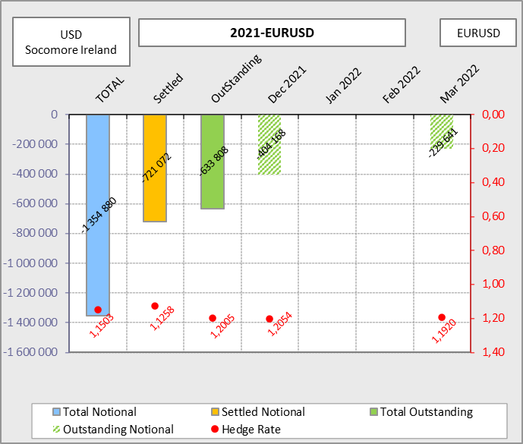
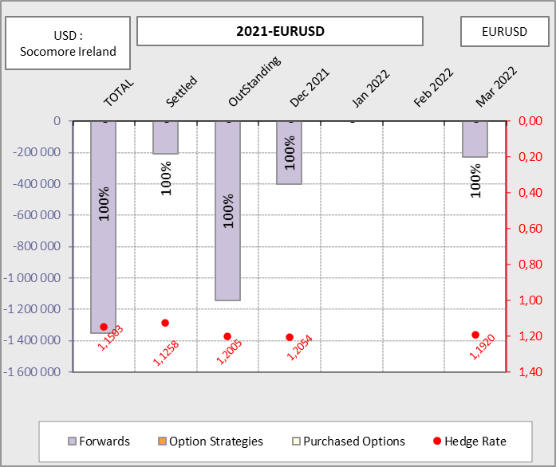
EURUSD – 2021 – Socomore Ireland

Slide 35
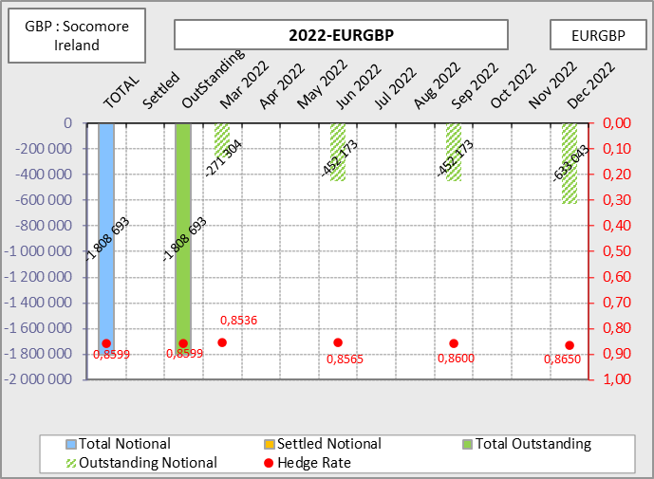
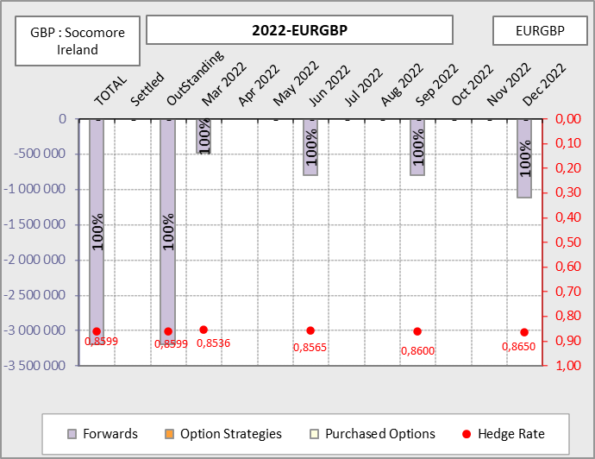
EURGBP – 2022 – Socomore Ireland

Slide 36

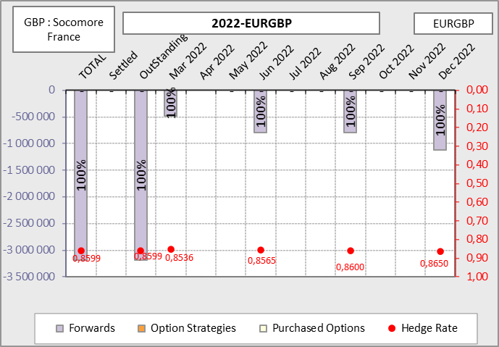
EURGBP – 2022 – Socomore France

Slide 37
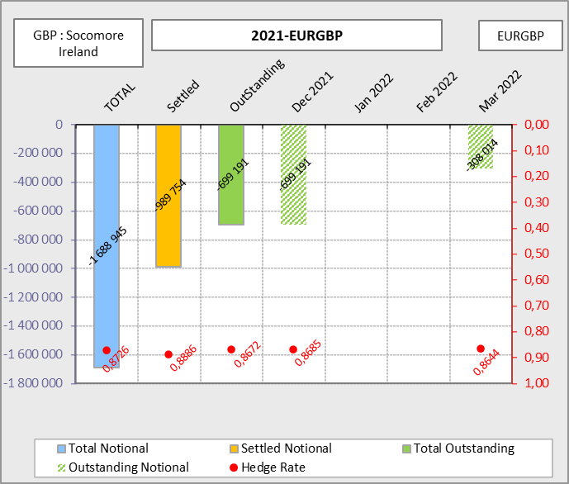
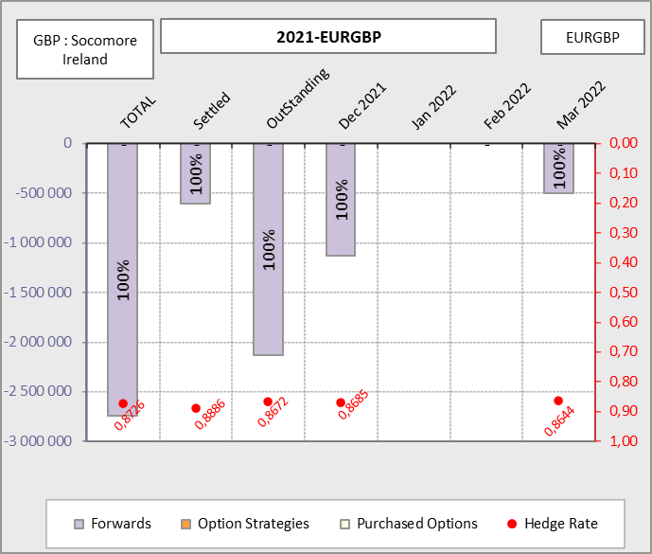
EURGBP – 2021 – Socomore Ireland

Slide 38
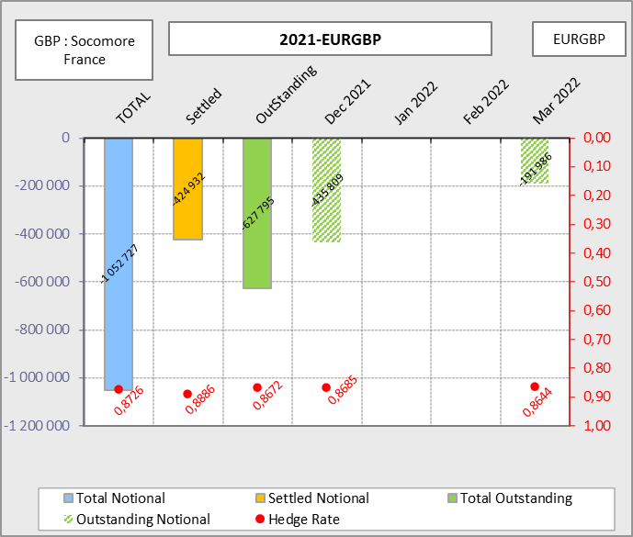
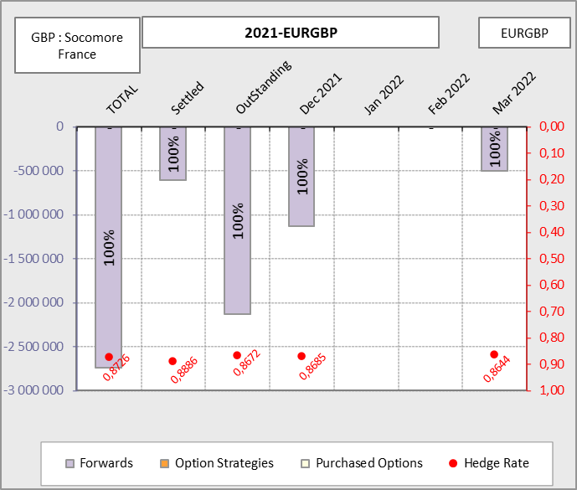
EURGBP – 2021 – Socomore France

Slide 39
Hedging Summary - 2020
EURGBP |  | Hedge Reference |  | Hedged notional | Exposure (GBP) |  | Hedge Rate |  | Budget 2020 |  | Hedge Rate |  |  | Hedging performance
Groupe Socomore |  | 2020 - Bilan |  | 176 245 | 176 245 |  | 100% |  | NA |  | 0,8584 |  |  | -
Socomore France |  | 2020 - Bilan |  | 55 757 | 55 757 |  | 100% |  | NA |  | 0,8584 |  |  | -
Socomore Ireland |  | 2020 - Bilan |  | 515 377 | 515 377 |  | 100% |  | NA |  | 0,8584 |  |  | -
Total* |  | 2020 - Bilan |  | 747 379 | 747 379 |  | 100% |  | NA |  | 0,8584 |  |  | -
*A mettre à jour une fois la livraison des flux finaux par les filiales

Slide 40
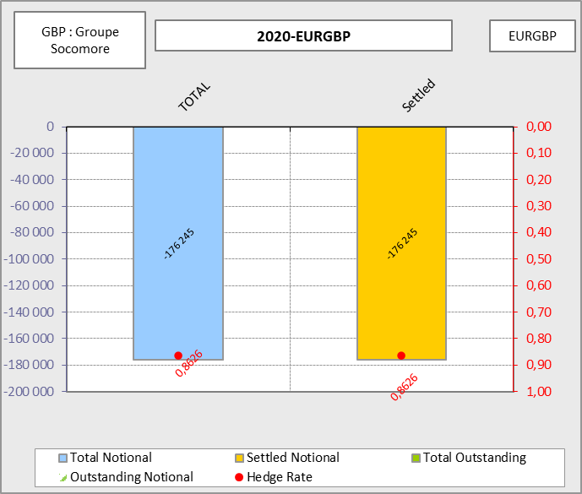
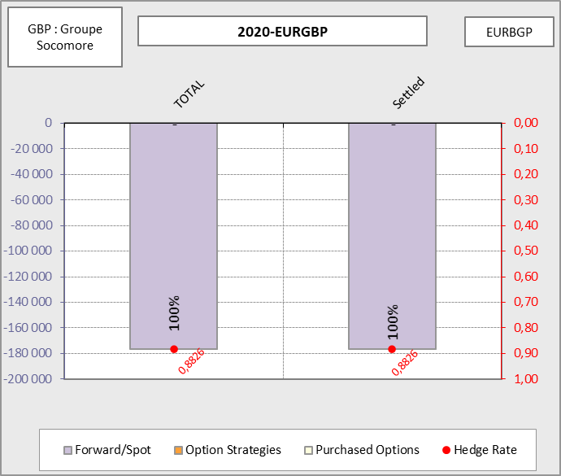
EURGBP - 2020-EURGBP

Slide 41
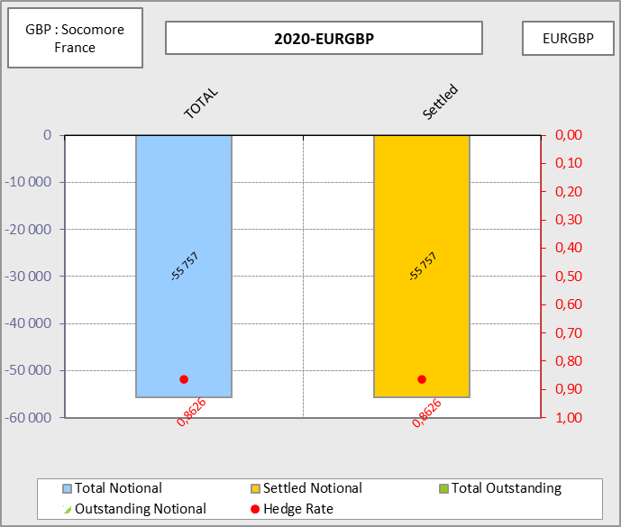
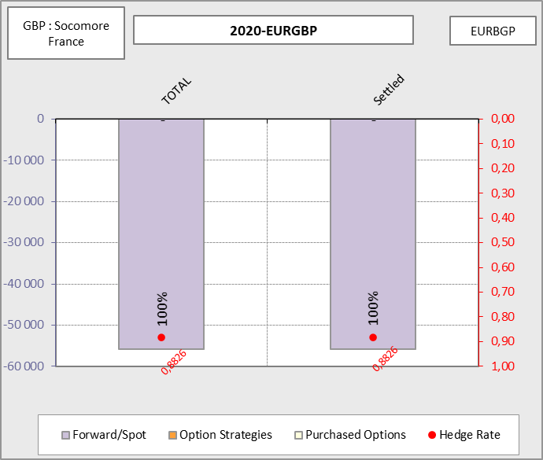
EURGBP - 2020-EURGBP

Slide 42
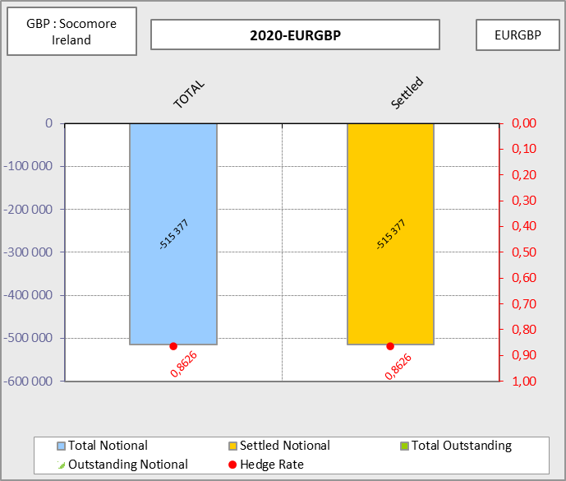
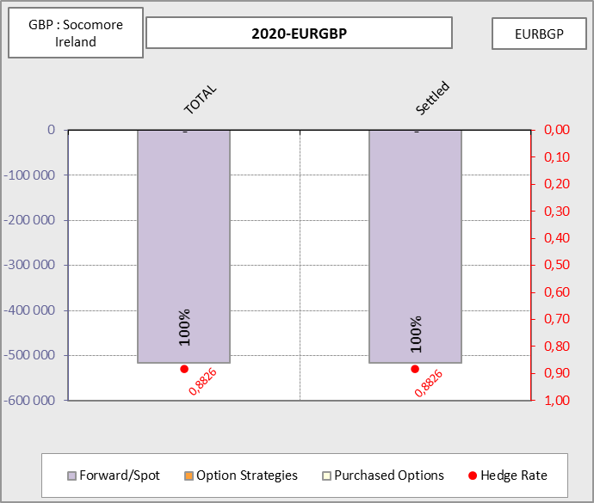
EURGBP - 2020-EURGBP

Slide 43
KERIUS Finance Suisse SARL
Chemin de Blandonnet 2,
1214 Vernier - Genève, Suisse
Tel : + 41 22 566 40 52
RC Genève, numéro fédéral: CH-660-2330011-1
KERIUS Finance SAS
17 rue Dupin,
75006 Paris, France
Tel: +33 1 83 62 27 61
RC Paris: 520 300 948
Immatriculé au Registre Unique des Intermédiaire en Assurance, Banque et Finance (ORIAS) sous le n°13000716 au titre des activités de Conseiller en Investissements Financiers, enregistré auprès de l’Association Nationale des Conseils Financiers-CIF, association agréée par l’Autorité des Marchés Financiers .
www.kerius-finance.com
Sébastien Rouzaire
s.rouzaire@kerius-finance.com
2013-12-04

Slide 44
AVERTISSEMENT - DISCLAIMER
Ce document a été préparé à l’usage des services financiers du Client. Ce document ou son contenu ne doivent pas être communiqués ou diffusés en externe sans l’accord préalable écrit de KERIUS FINANCE .
Pour ce document, KERIUS FINANCE a été amenée à utiliser des informations et données chiffrées fournies par le Client. KERIUS FINANCE a pris ces données en compte sans réaliser de procédure d’audit et n’émettra en conséquence aucune opinion sur leur fiabilité. Ce document ne constitue pas une documentation contractuelle des transactions éventuellement décrites, ni une recommandation ou une sollicitation de mettre en place les transactions décrites. Tout Client intéressé par ce type de transactions ou procédure doit mener ses propres analyses pour vérifier l’adéquation à ses besoins, ainsi que les conséquences, notamment fiscales et comptables. Il lui appartient également de prendre les dispositions nécessaires à la mise en œuvre des décisions qu’il aura prises.
Ni KERIUS FINANCE ou ses administrateurs ou employés ne pourront être tenus responsables des conséquences de l’utilisation de ce document ou de la mise en place, totale ou partielle, par le client, des idées ou opérations décrites.
This document has been prepared for the Finance department of the Client. It must not be communicated or published externally without prior written consent of KERIUS FINANCE
For this document, KERIUS FINANCE used information and data provided by the Client. The Client agrees that KERIUS FINANCE took this information into account without auditing them or checking their accuracy and, as a consequence, without producing any opinion on their reliability. Please note that this document does not constitute a contractual documentation of the transactions or processes that may be described, nor a recommendation or solicitation to enter into the transactions or processes described herein. If the Client is interested in setting up this type of transactions or processes, the Client should conduct his own analysis of the suitability to his needs. The Client must also verify the consequences of his decisions, including accounting and fiscal aspects. The Client is also responsible for the implementation of his decisions.
Neither KERIUS FINANCE nor its directors and employees accept liability for any loss or damage resulting from the use of this document and expressly excludes all liability in respect of any implication of the described ideas or transactions on the Client’s own specific particulars.
2013-01-01

